Slide 1
Beyond ‘Thoughts and Prayers’: Religion, Action, and Survival in Dystopian Fiction
By: Ellorie Kenyon

Slide 2
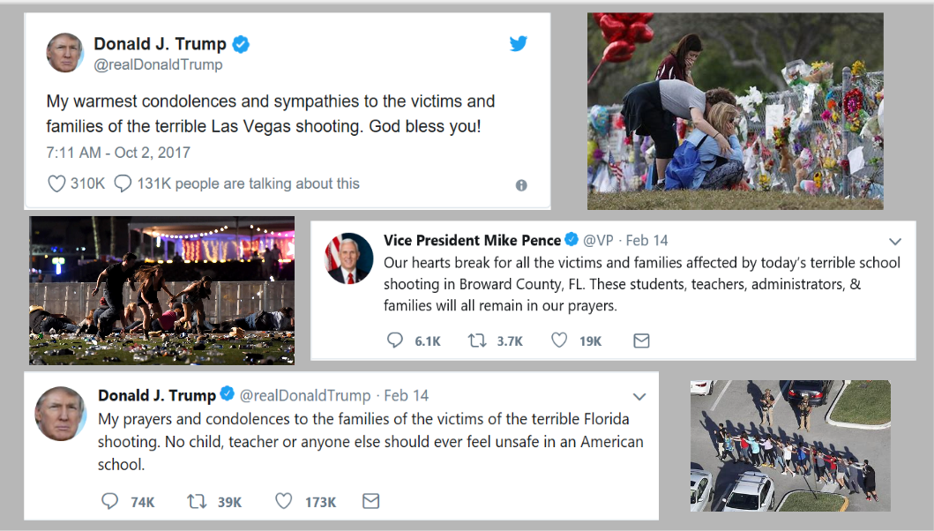

Slide 3
Dystopian Literature: a work of fiction set in a violent or corrupt society that is unfamiliar to the reader or the characters, and which magnifies contemporary issues to a degree that forces readers to engage and draw meaningful conclusions about their own society’s injustices from the text

Slide 4
Uses of Religion in Dystopian Novels:
Bring Comfort and Hope to apocalypse survivors
Provide Structure in an Illogical World
Unify People and Groups
Implement Government Authority and Oppression

Slide 5
Novels Used in my Paper:
Parable of the Sower (Octavia Butler, 1993)
Station Eleven (Emily St. John Mandel, 2014)
The Handmaid’s Tale (Margaret Atwood, 1985)
The Young World (Chris Weitz, 2014)
Delirium (Lauren Oliver, 2011)
Brave New World (Aldous Huxley, 1932)

Slide 6
Religion as Comfort
“Elizabeth sat near [Tyler] with her eyes closed, lips moving constantly, rapidly, in some repeated prayer” (Mandel 245).
“Tyler wore a sweater of Elizabeth’s that went to his knees….he kept to himself mostly, reading his comic books or Elizabeth’s copy of the New testament” (Mandel, 253).

Slide 7
Religion as Logic in an Illogical World
“Some people were saved. People like us.” [said Tyler] “What do you mean, ‘people like us’?” [Clark said] “People who were good,” Tyler said. “People who weren’t weak.” “Look, it’s not a question of having been bad or… the people in there, in the Air Gradia Jet, they were just in the wrong place at the wrong time.” “Okay,” Tyler said. Clark turned away, and Tyler’s voice resumed...reading aloud: “‘She will be consumed by fire, for mighty is the Lord God who judges her.’” (Mandel 260)

Slide 8
Religion as a Unifier
“My people and I,” [Adult Tyler said] “when we speak of the light, we speak of order. [This town we have taken over] is a place of order. People with chaos in their hearts cannot abide here.” (Mandel 61)

Slide 9
Religion as Government Institution
“And Leah said, God hath given me my hire, because I have given my maiden to my husband,” says the Commander… Serena has begun to cry… She always does this, the night of the Ceremony… “Now we will have a moment of silent prayer,” says the Commander. “We will ask for a blessing, and for success in all our ventures.” (Atwood 90)
“The Bible is kept locked up… It is an incendiary device: who knows what we’d make of it, if we ever got our hands on it? We can be read to from it, by him, but we cannot read.” (87)

Slide 10
Paul Froese: Religion and American Politics from a Global Perspective
“American political candidates make a big deal of their “commitment to faith.” In a systematic analysis of national political speeches, Domke and Coe find that religious rhetoric has steadily been on the rise among both Republicans and Democrats since the Nixon administration. The religious language of our political leaders is so pervasive that it can inspire alarm when it is absent. Barack Obama and Mitt Romney both had to address the concerns over their religiosity head-on; in both cases, they attempted to quell fears of their supposed religious deviance by maintaining that they are faithful Christians.” (650)

Slide 14
Religion As:
Comfort
Logic
Community-Builder
Justification for Authority

Slide 15
James 2: 14-17 (NIV)
“What good is it, my brothers and sisters, if someone claims to have faith but has no deeds? Can such faith save them? ¹⁵Suppose a brother or a sister is without clothes and daily food. ¹⁶If one of you says to them, “Go in peace; keep warm and well fed,” but does nothing about their physical needs, what good is it? ¹⁷In the same way, faith by itself, if it is not accompanied by action, is dead.”

