Slide 1
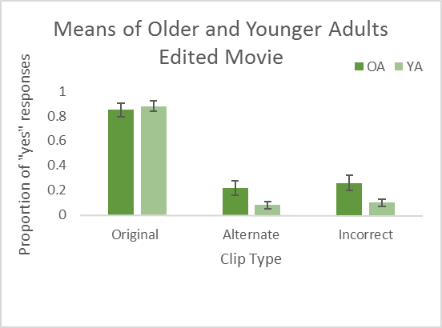
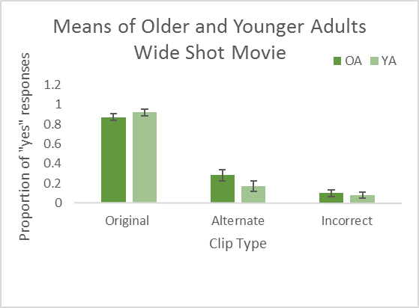
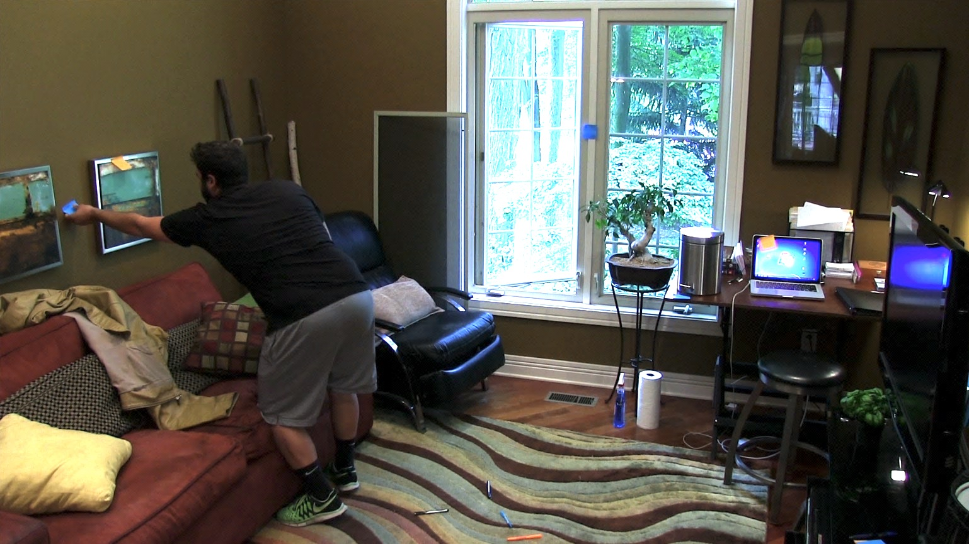
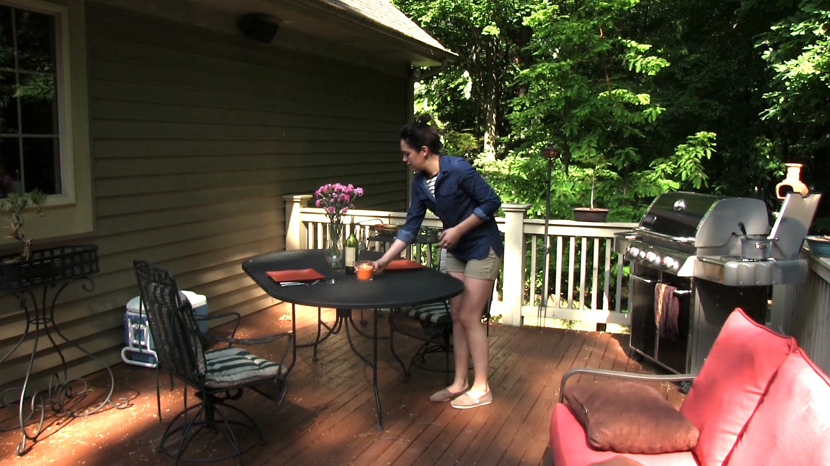
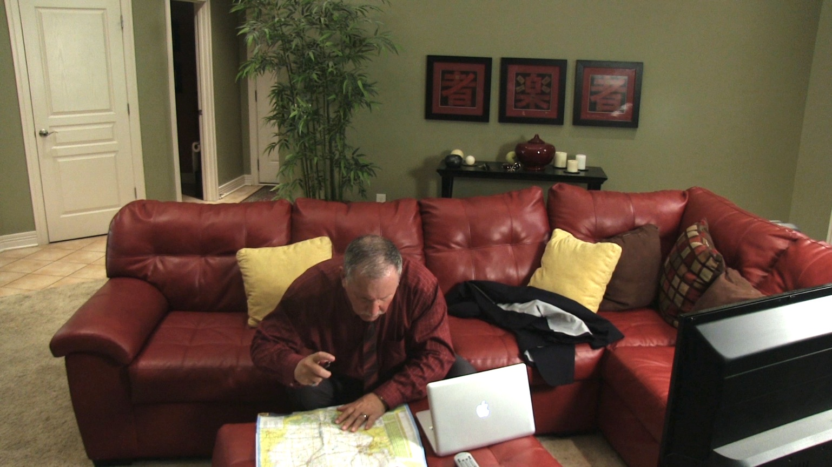
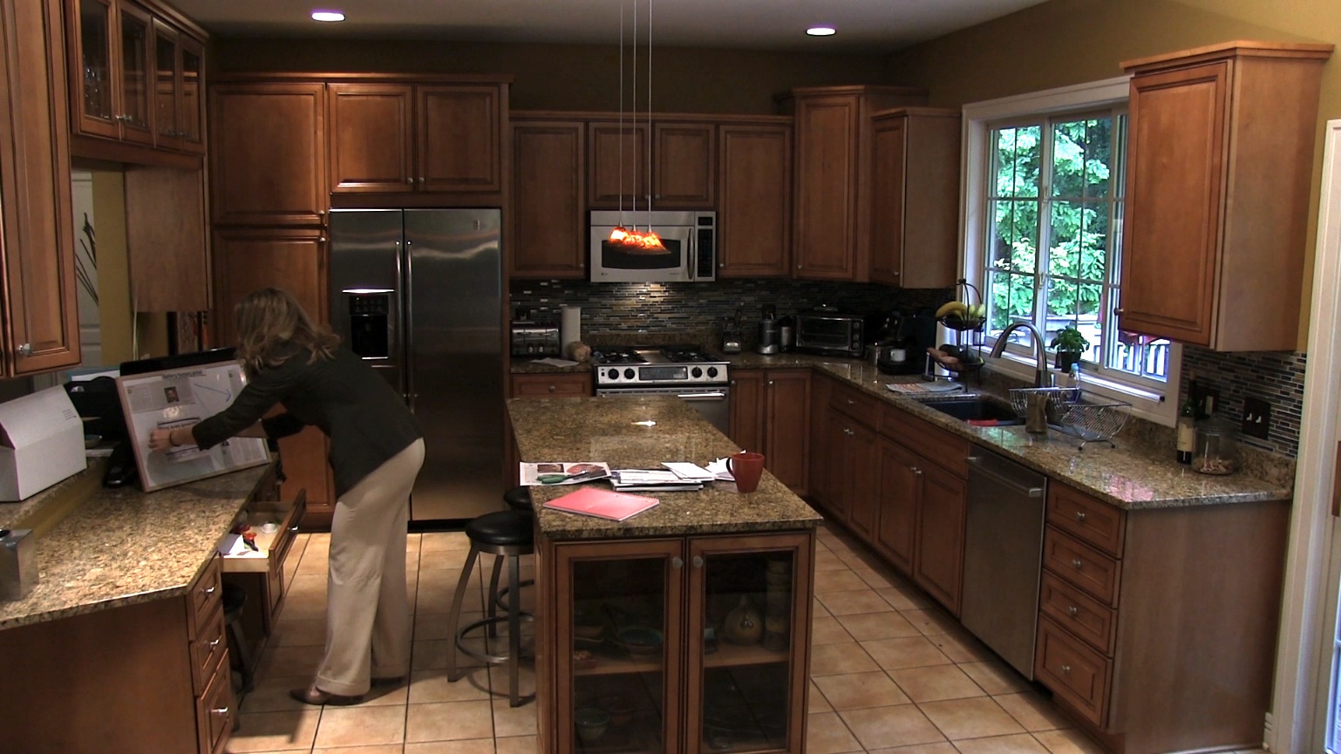
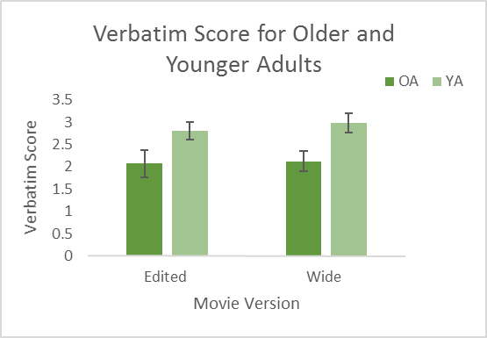
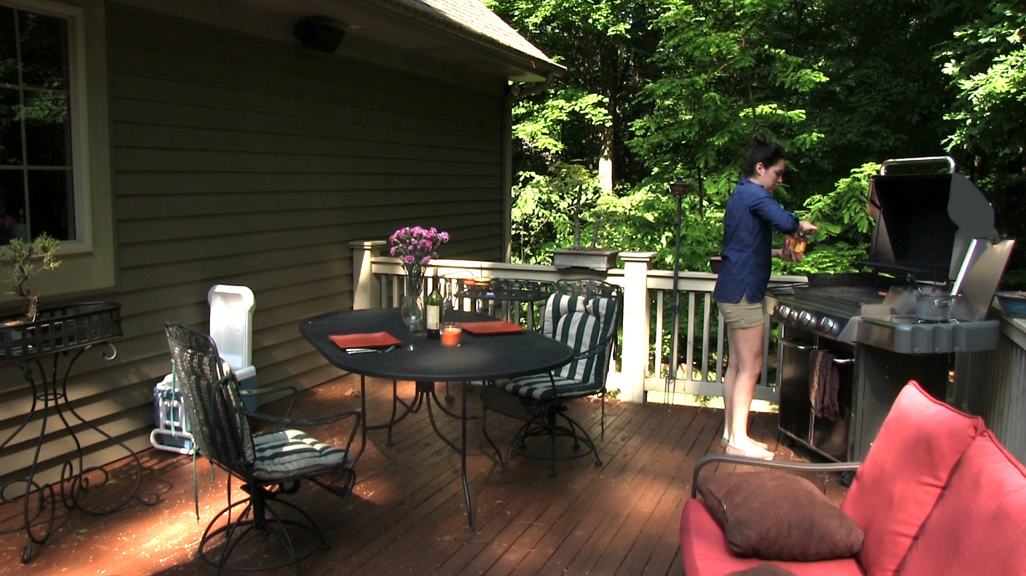
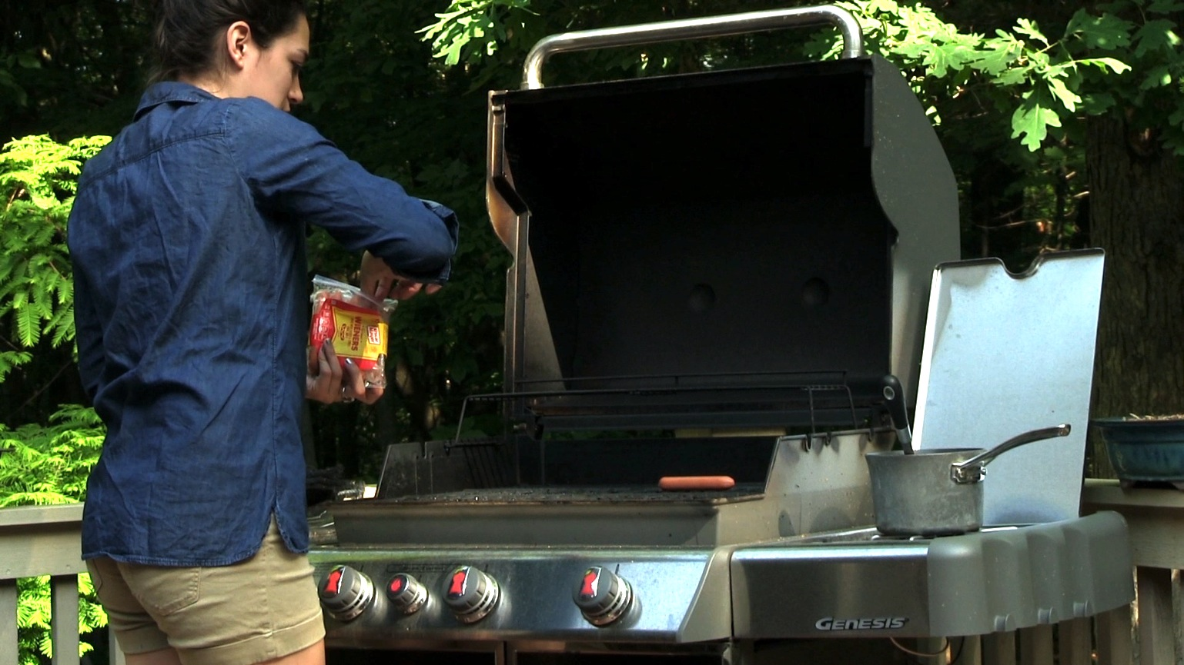
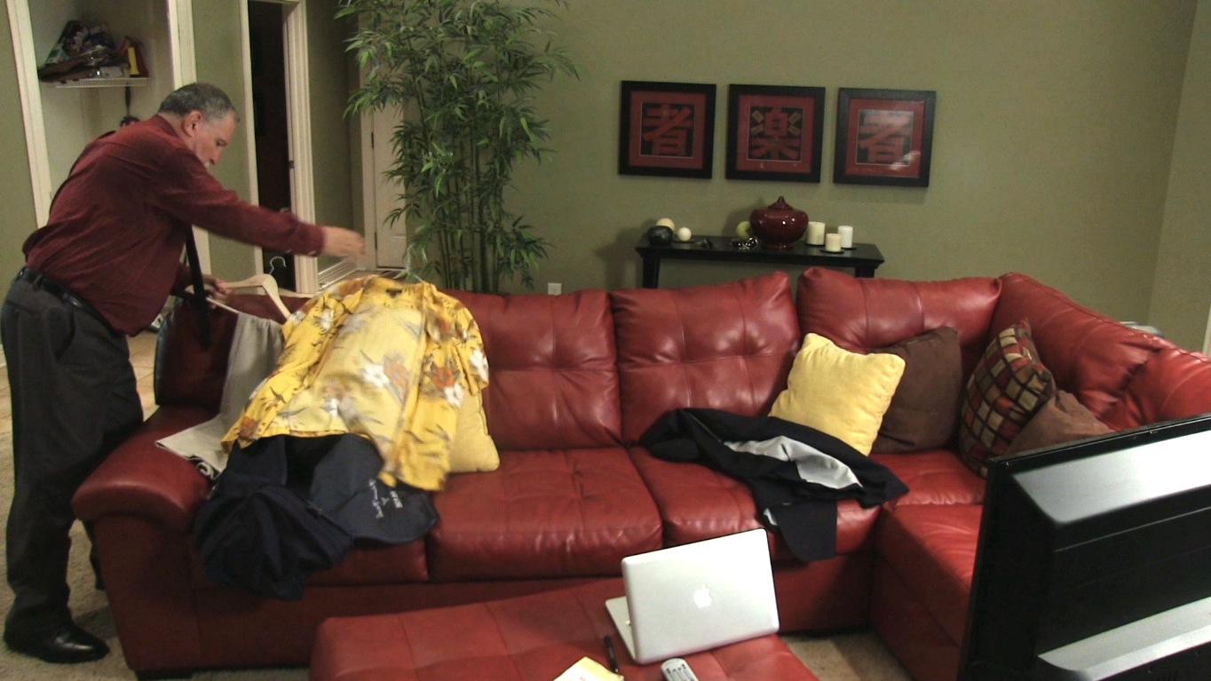
Film Editing, Event Segmentation, and Memory in Older Adults
Christopher A. Kurby and Sydney M. Cody
Department of Psychology
Grand Valley State University
Preliminary Results
Introduction
When people view every day activities, they naturally divide up the activity into smaller parts, or events. ¹ People perceive an event boundary when there is a change in events, such as a new character entering or a spatial shift. Research has shown that older adults tend to have worse memory for events than younger adults, and this is related to reduced event segmentation ability. ² This reduced event understanding may be due to a declining ability to focus attention on important changes in the activities. Recent research on movie comprehension shows that Hollywood-style editing can strongly guide attentional processing. ³ This effect of editing may help guide event understanding in the viewer. ³ The purpose of this study is to test whether movie editing techniques can improve event memory in older adults.
Methods
Participants:
50 younger adults 14 older adults
For preliminary analysis: We randomly selected 10 older adults and 10 younger adults.
Procedure:
Participants watched four movies two times, and segmented them into large and small meaningful units of activity.
Participants watched one of two versions:
Recognition test: Participants watched short movie clips and identified whether or not they were from the movie they just watched.
Older adults had poorer memory than younger adults
Older adults said “yes” to alternate clips more often than younger adults
Older adults said “yes” to incorrect clips more often than younger adults
Clean up
Outdoor
bbq
Prepare
for trip
Kitchen
activity
There was no difference in verbatim memory between the wide or edited versions
Wide shot
Edited with close ups
d' = z(HR_original) - z(FA_alternate)
Conclusions
Older adults have poorer memory for event details than younger adults.
Film editing may not improve memory for event details.
Final analyses will be conducted upon completion of data collection.
Clip Type | Original | Alternate | Incorrect
Description | Original clips taken directly from the movie | Clips that were similar in action but differ in details | Clips that did not happen in the movie
Example
Hypotheses
Older adults will have poorer memory for events in the movies than younger adults.
Movie editing will improve event memory, particularly for older adults.
References
¹ Kurby, C.A., & Zacks, J.M. (2008). Segmentation in the perception and memory of events. Trends in Cognitive Sciences, 12, 72-79.
² Zacks, J. M., Speer, N. K., Vettel, J. M., & Jacoby, L. L. (2006). Event understanding and memory in healthy aging and dementia of the alzheimer type. Psychology and Aging, 21(3), 466-482.
³Loschky, L. C., Larson, A. M., Magliano, J. P., & Smith, T. J. (2015). What would jaws do? the tyranny of film and the relationship between gaze and higher-level narrative film comprehension: E0142474. PLoS One, 10(11)
Notes:
Center all titles
Change words “create and “detect”
Create bridge from OA worse-explain why-bring in how films help
State hypotheses
Put graphs parallel
Include equation under 3rd graph
Use more bullet points less words
Say how many participants total then say randomly selected 10 each for pre lim results
Use pictures to help explain methods
Don’t let words touch the sides
Conclusion use 3 bullet points (OA not as good at memory for details, no effect of film editing, will know more when final analysis is completed
How to get movies-kurby documents lab data naturalistic movies
Show data on graph
SOURCES!
Heading over pictures to say wide and edited movies

