Slide 1
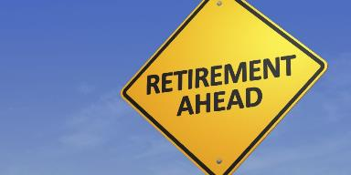
Currency for Retirement: Investing in Physical Capital
Chris Dondzila, PhD
Steve Glass, PhD, FACSM
Department of Movement Science
Grand Valley State University

Slide 2
What Does Retirement Mean To You?
Notes:
Travel
Family
Activities and Hobbies
Nest Egg

Slide 3
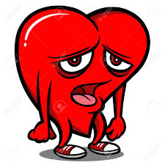
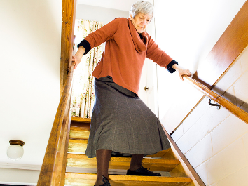
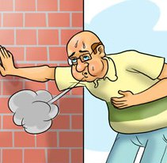
The Reality
More than just finances! What about your body???
Average retirement age is 67,
Decades of past habits
The years ahead
Notes:
CV function goes down: heart, vessels
Muscles and bones weaken
Activities become harder, and then avoided more
Balance, mobility, and confidence diminish

Slide 4
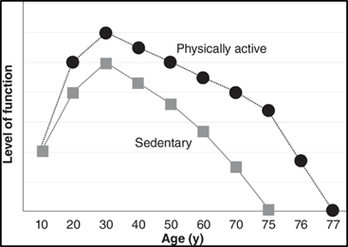
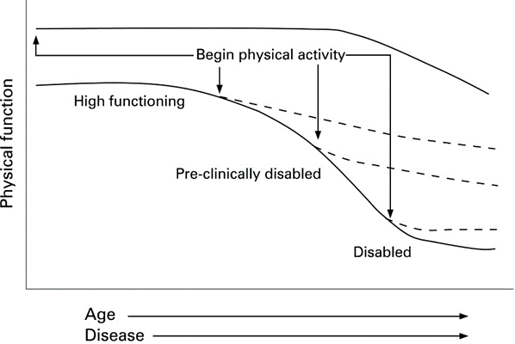
Not All is Lost!!!
Mid-Life Investing
What you do through life (physical activity-wise) matters.
Cardiovascular, muscular, flexibility, mobility all higher in those who exercise vs those who don’t
The Re-investment During Retirement
Perfect time to make “catch up payments”
Human body is capable of improving across a variety of areas – even if only increasing activity by a little bit!

Slide 5
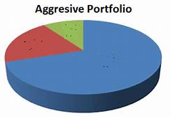
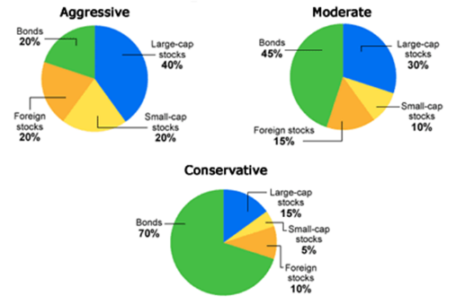
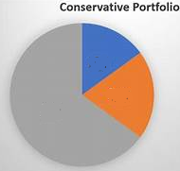
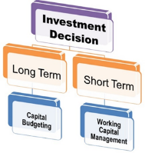
How Do I Invest? What Can I Do?
HIIT
Leisure Activity
Strength and Aerobic Training
Functional Training
Light Strength Activity
Light Activity

Slide 6
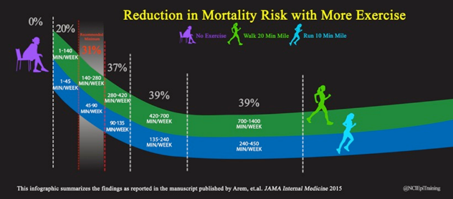
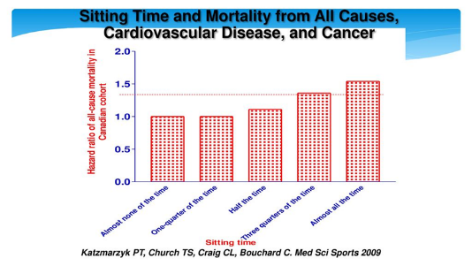
Everyday Activities – Get the Body MOVING
Conservative Investing

Slide 7
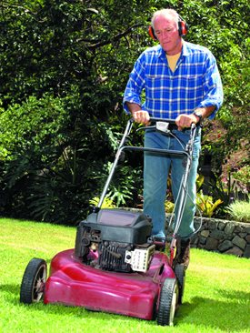
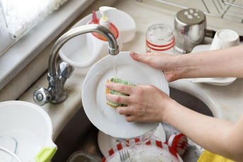
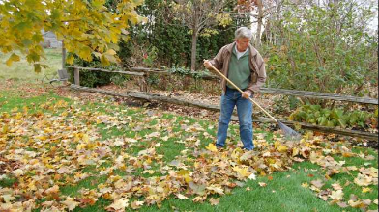
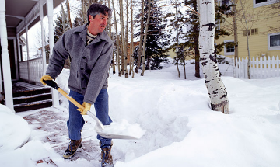
Everyday Activities – Get the Body MOVING
Conservative Investing
It is not true that you have to “exercise” to get health benefits
Think about a typical day and the activities you do.
(morning, afternoon, evening)
Are there (safe) alternatives?

Slide 8
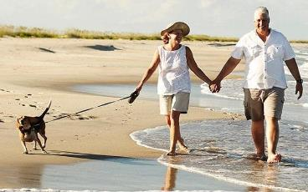
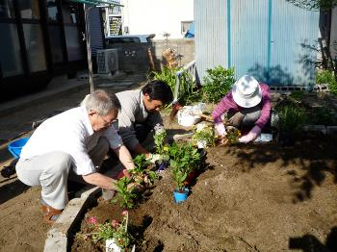
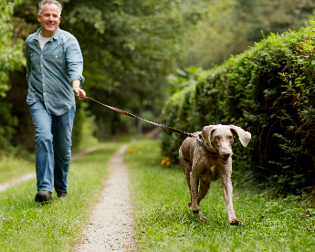
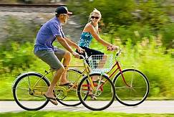
Walking and Leisure Activities
It is not true that you have to “exercise” to get health benefits

Slide 9
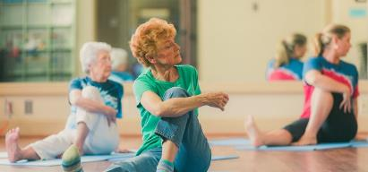
Stretching
10 minutes total for major muscle groups
4 repetitions per muscle group
2 or 3 days per week

Slide 10
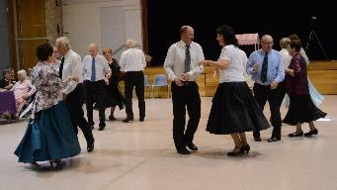
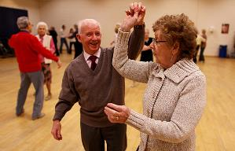
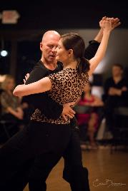
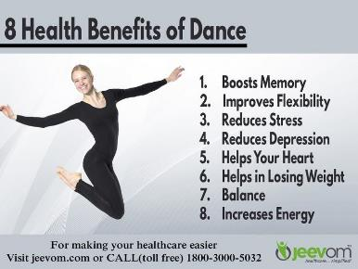
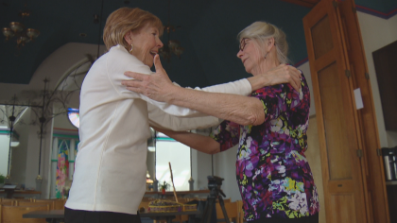
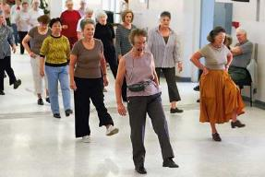
Dance
Moderate Investing

Slide 11
Resistance Training
Moderate Investing
Moderate Strength Gain
Some load is better than no load
Lift to moderate fatigue
As stamina increases, maybe increase intensity
Allow rest and recovery
Use proper technique!
More “Aggressive”
Lift at least 60% of 1 rep max
Lift to fatigue
Progress to heavier loads as repetitions get to 15
Recommendations: 8-10 exercises done on 2-3 nonconsecutive days for 10-15 repetitions

Slide 12
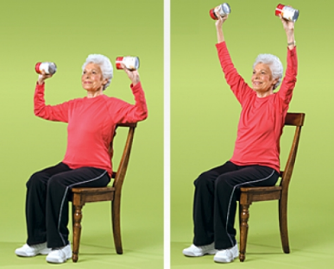
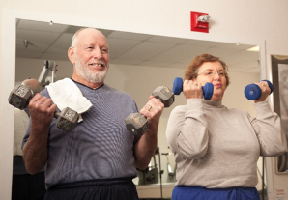
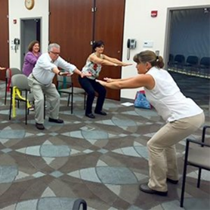
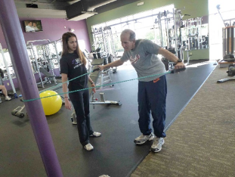
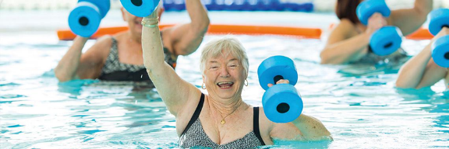
Resistance Training

Slide 13
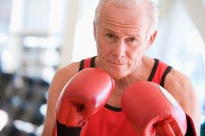
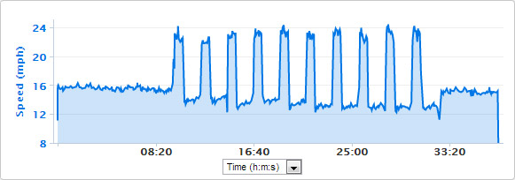
High Intensity Interval Training (HIIT)
Aggressive Investing
Remember that “High Intensity” is relative to your fitness!
The more intense the workout, the shorter the work interval…. And the longer the rest
Rest can be active (walking, jog) or total rest

Slide 14
How Much Time is This Going to Take?? (It Does Not Have to be a Lot)
Morning | Late Morning | Mid-Day | Afternoon | Evening
Stretch & Walk the Dog (Daily) | Yardwork (2x weekly) |  | Walk | Yoga (2x weekly)
 |  | Resistance Training (2x weekly) |  | Dancing (2x weekly)
 | HIIT (2x weekly)
Key
Conservative
Moderate
Aggressive

Slide 15
Community Resources
National Institute on Aging: Go4Life
YMCA
West Michigan Area Agency on Aging
Senior Neighbors
American College of Sports Medicine (ACSM.org)

