Slide 1
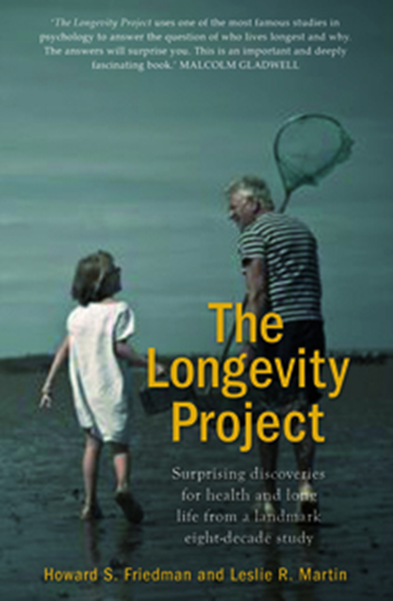
Throw Your Heart into it, and the Rest Will Follow!
LESLIE R MARTIN, PhD
Professor of Public Health,
Loma Linda University
Research Professor,
University of California, Riverside

Slide 2
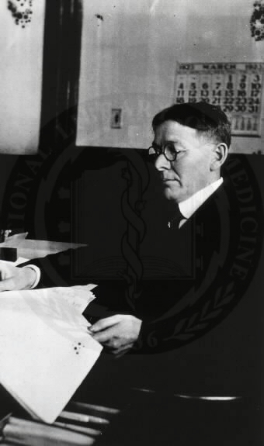
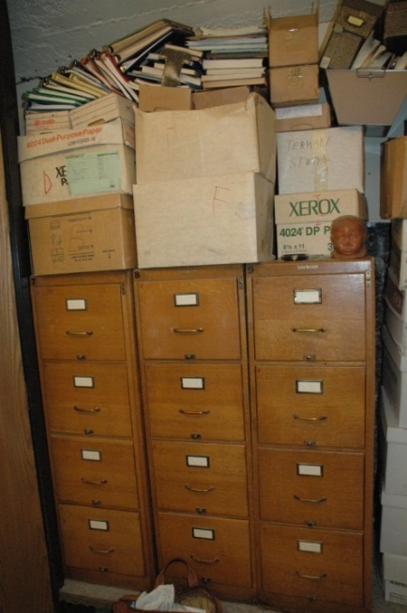
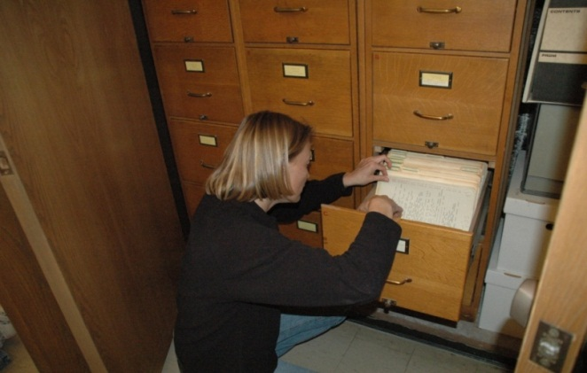
Our Extension of Terman’s Life Cycle Study
Terman: Examined life paths of bright children; not health-focused
Our Study: Person-situation, life-span development patterns and health/ longevity outcomes

Slide 3
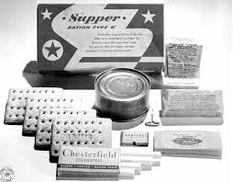
Terman Life Cycle Participants
Famous participants include Jess Oppenheimer, the creator of the I Love Lucy show and Ancel Keys, creator of the military K-Ration.
Photos: (1) LUCYlibrary.com; (2) strangemilitary.com

Slide 4
In response to clever “Termites”
We decided to call ourselves:
THE TERMAN-ATORS
We dubbed Howard “Chief Termanator”
You can see the resemblance…
Photos: (1) MovieNetwork DBIl; (2) Miriam Schustack

Slide 5
Terminator Termanator
Photos: (1) MovieNetwork DBIl; (2) Miriam Schustack

Slide 6
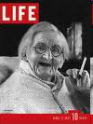
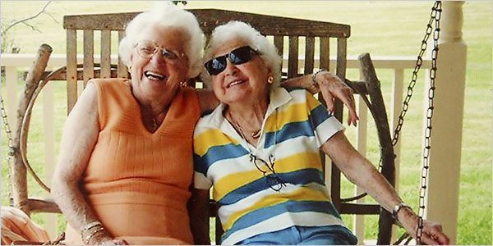
Limits of Centenarian Studies & “It’s all in the genes!”
Josephine Tesauro (left), active and healthy, with her identical twin sister who is incontinent, has had a hip replacement, has a degenerative disorder that destroyed her vision, and has dementia. (NY Times, 2006)
1937
Sorry, but if you eat lots of yoghurt and smile every day, you may still die!

Slide 7
Some common problems
Short-term studies and follow-ups
Failure to consider all outcomes (all-cause dilemma)
Use of wellness predictors (e.g., lowered cholesterol,
weight loss, immune changes, lower blood sugar,
increased exercise) as outcomes.
These problems are due to lack of comprehensive models

Slide 8
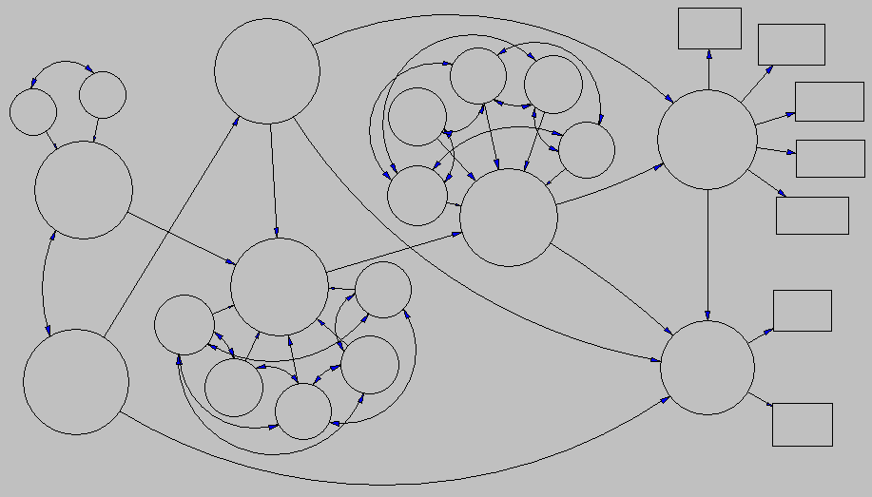
A more comprehensive model…
▲
Physical Health
Subjective well-being
Adult Personality
Phys Activity
SWB
Health
Health
Martial Status
Cognitive Function
Phys Activity
Healthy Aging
Social Competence
Functioning 1922
▲
Social Support
▲
Functioning 1960
Productivity
▲
Functioning 1940
▲
Phys Activity
Social Support
▲
Years lived
Child
Personality
Health
Longevity
Marital Status
SWB
Cause of Death
▲
Multi-Construct Life-span Model:
Childhood, adulthood, old age—
With valid outcomes

Slide 9
A Biopsychosocial Model & Longitudinal Design
Personality
Biology/ Genetics
Health Behaviors
Physiological Reactivity
Social Interactions
Health & Illness

Slide 10
A Biopsychosocial Model & Longitudinal Design
Personality
Biology/ Genetics
Health Behaviors
Physiological Reactivity
Social Interactions
Health & Illness

Slide 11
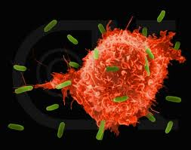
Pathways/ Mechanisms: Homeostasis
Disruption in Homeostasis
(immune system, etc.)
Personality
Poor Health
Photo: (1) biologicnr.com

Slide 12
Pathways/ Mechanisms: Unhealthy Behaviors
Unhealthy Behaviors
Personality
Poor Health
Photo: (1) blogs.independent.co.uk

Slide 13
Pathways/ Mechanisms (underlying 3rd variable)
Personality
Early Biology
Health and Longevity
Photo: (1) earlyyearsparenting.wordpress.com

Slide 14
Pathways: Select or Elicit Unhealthy Situations
Personality
Unhealthy Environments
Poor Health
Photo: (1) incaseimgone.com

Slide 15
Conscientiousness
Also called Lack of Impulsivity
Childhood: Ratings (parent & teacher) of prudence, freedom from vanity, conscientiousness
Adulthood: Self-report personality scales--persistent, careful, etc.
Validated new indexes w/ measurement invariance in contemporary sample and with rational ratings

Slide 16
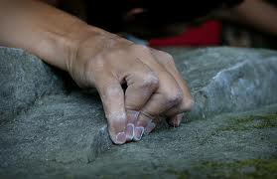
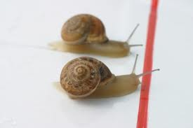
Can Conscientiousness Predict Mortality Risk? Yes!
Child: InterQ rh(1,252) = 0.81, p<.001
Adult: InterQ rh(1,071) = 0.82, p<.001

Slide 17
Conscientiousness & Survival
Percent Alive vs. Terminated by Age 70
High Adult Conscientiousness
Low Adult Conscientiousness

Slide 18
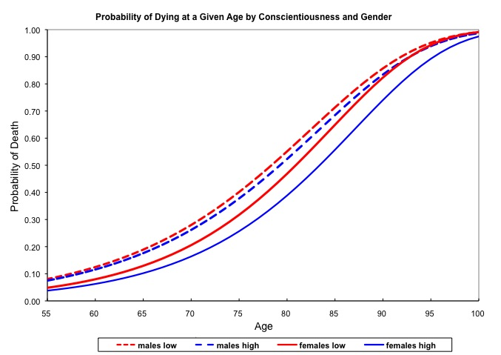

Slide 19
The more conscientiousness, the better!
Probability of death based on conscientiousness at two time points

Slide 20
Pathways/ Mechanisms: Unhealthy Behaviors
Unhealthy Behaviors
Personality
Poor Health
Photo: (1) blogs.independent.co.uk; (2) healthytravelblog.com

Slide 21
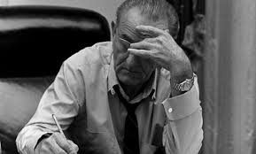
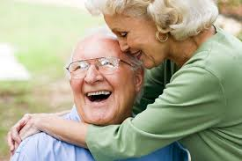
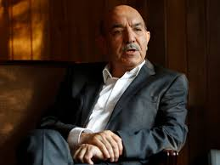
Healthy trajectories
Photo: (1) theweek.com; (2) hearthside-homeinstead.com; (3) lifescience.com; (4) theguardian.com; (5) news.nationalpost.com

Slide 22
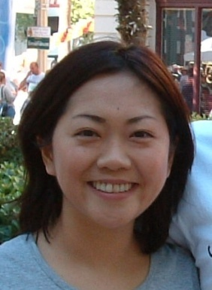
Cheerfulness, optimism, sense of humor
Optimism, cheerfulness, positive thinking… qualities that promote good health, right?
Not always!
Cheerfulness/optimism and sense of humor ( α = .52) rated by parents/teachers in 1922 → rh(1,178) = 1.22, p<.01
Why?

Slide 23
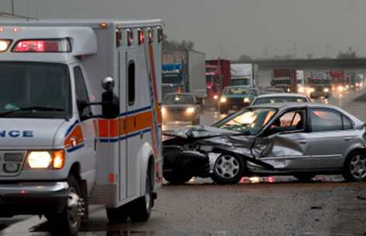
Pathways/ Mechanisms: Unhealthy Behaviors
Unhealthy Behaviors
Personality
Poor Health
Photo: (1) blogs.independent.co.uk; (2) texasauto.com

Slide 24
Pathways: Select or Elicit Unhealthy Situations
Personality
Unhealthy Environments
Poor Health
Photo: (1) incaseimgone.com; (2) iowabiz.com

Slide 25
Common View of Stress and Illness
Immune Suppression
or
Cardiovascular
Reactivity
Or
Inflammation
STRESS
DISEASE
(cancer, heart
disease,
premature
mortality)

Slide 26
Common Advice
Relax, Chill Out
Don’t Worry
Don’t Work Too Hard
Cheer Up, Party, Laugh
Be Extraverted
Retire & Play Golf
STRESS
DISEASE
(cancer, heart
disease,
premature
mortality)
Immune Suppression
or
Cardiovascular
Reactivity

Slide 27
Bad Common Advice
Relax, Chill Out
Don’t Worry
Don’t Work Too Hard
Cheer Up, Party, Laugh
Be Extraverted
Retire, Play Golf
STRESS
DISEASE
(cancer, heart
disease,
Premature
Mortality)
Immune Suppression
or
Cardiovascular
Reactivity

Slide 28
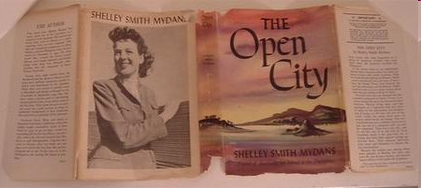
Shelley Smith Mydans
Photos: (1) portrait: photobucket.com; (2)interview: Carl Mydans/Life Magazine; (3) book jacket: pinoyhistory.com; (4) couple: corbis.co.in

Slide 29
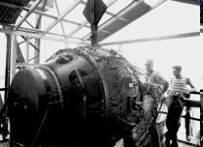
norris bradbury
Photos: (1) portrait: wikipedia.com; (2) museum: wikipedia; (3, 4) “Gadget” & Trinity test: Life Photo Archive

Slide 30
Edward Dmytryk
Photos: (1) portrait: Spartacus Educational; (2) books: Amazon.com; (3) movie: IMDb internet movie database

Slide 31
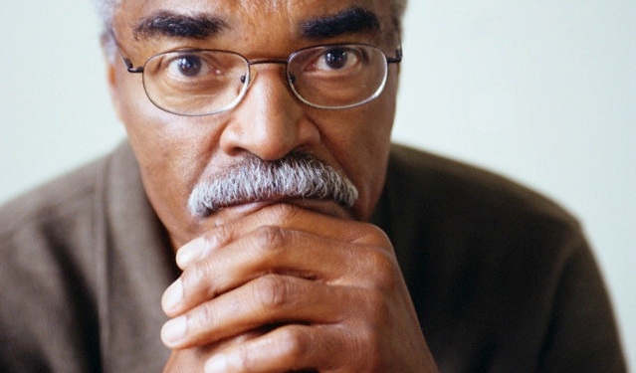
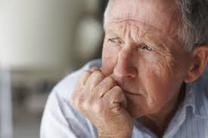
Counterintuitive findings
Hard work, if it is meaningful, is actually good for you!
So, don’t just retire and play golf! It’s important to have something to throw your heart into.
A bit of worrying is not as bad as we often think…
…and if you’re a man, it may help you live longer!
Photos: (1) businesspundit.com; (2) 4-men.org; (3) sabp.nhs.uk

Slide 32
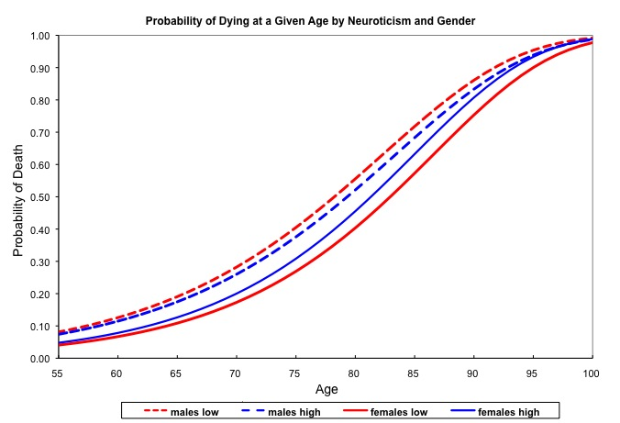

Slide 33
Men low on C and N die soonest; women high on C low on N live longest

Slide 34
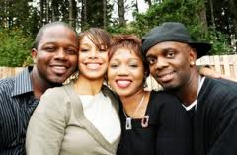
Social Connections
Feeling Connected / Cared For
Photos: (1) couples: iStockphoto/Yuri_Arcurs, miamiurbanleague.org; (2) swim: 1dentalhealthblog.wordpress.com; (3) woods: quiltethnic.com; (4) family: homesforarmy.com

Slide 35
Social Connections
Feeling Connected / Cared For
Number of interactions
Photos: (1) couples: iStockphoto/Yuri_Arcurs, miamiurbanleague.org; (2) swim: 1dentalhealthblog.wordpress.com; (3) woods: quiltethnic.com; (4) family: homesforarmy.com

Slide 36
Social Connections
Feeling Connected / Cared For
Number of interactions
Helping Others
Photos: (1) couples: iStockphoto/Yuri_Arcurs, miamiurbanleague.org; (2) swim: 1dentalhealthblog.wordpress.com; (3) woods: quiltethnic.com; (4) family: homesforarmy.com

Slide 37
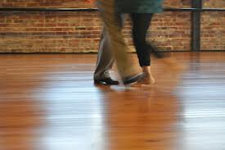
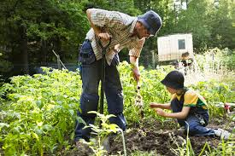
Marathonlessness is not a disease!
Photos: (1) idealbite.com; (2) escapetoyoga.com; (3) thehomegarden.com; (4) streetsblog.net

Slide 38
Throwing your heart into it…
Live a purposeful, conscientious life
Find meaning in work, experiences
Work hard at something you care about
When you retire, find another passion

Slide 39
Throwing your heart into it…
Live a purposeful, conscientious life
Find meaning in work, experiences
Work hard at something you care about
When you retire, find another passion
Strengthen social ties
Engage with family, friends, co-workers
Connect in ways that help others

Slide 40
Throwing your heart into it…
Live a purposeful, conscientious life
Find meaning in work, experiences
Work hard at something you care about
When you retire, find another passion
Strengthen social ties
Engage with family, friends, co-workers
Connect in ways that help others
A bit of worrying is ok
Prompts better planning, health behaviors

Slide 41
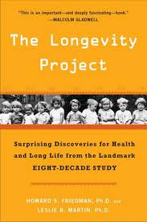
The Termination
of this talk
Our research is supported by the National Institute on Aging
[which does not necessarily endorse a word]
NIH / NIA
AG08825 (H. Friedman, PI)
AG15188 (L. Martin, PI)
AG027001 (C. Reynolds, PI)
JOIN US ON FACEBOOK AT THE LONGEVITY PROJECT

