Slide 1
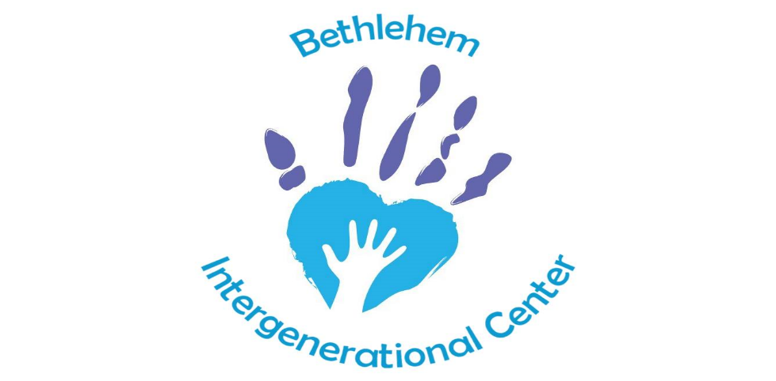
Caring for Generations For Generations to Come

Slide 2
1. Understand intergenerational care.
2. Understand how an intergenerational center operates in Grand Rapids.
3. List some key lessons learned in creating this model of care.
“We often hear about stepping outside ourselves, but rarely about stepping outside our generation.”
― Criss Jami, Killosophy
Objectives

Slide 3
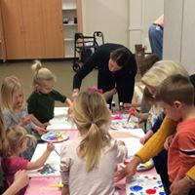
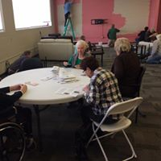
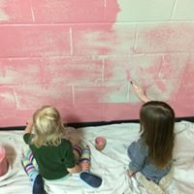
How we became BIC
Sites Visited
St. Anne’s
Address: 2801 E. Morgan Ave. Milwaukee, WI 53207
Phone: (414) 977-5000
Champion Intergenerational Center
Address: 240 N Champion Ave, Columbus, OH 43203
Phone: (614) 253-1185
Generations Together
Address: 4214 NE Hazelfern Pl, Portland, OR 97213
Phone: (503) 652-7344
Generations Crossing
Address: 3765 Taylor Spring Ln, Harrisonburg, VA 22801
Phone: (540) 434-4901

Slide 4
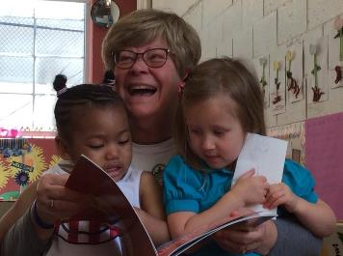
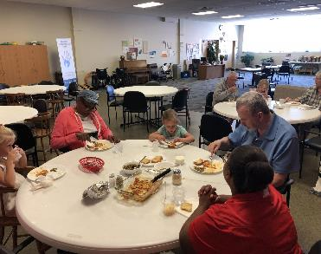
Bethlehem Intergenerational Center
Wing dedicated to the care and education of young children ages 6 weeks-5 years, with school age programming during the summer- Licensed by the State of Michigan and NAEYC Accredited
Wing dedicated to the care and enrichment of persons 60 and older
Program encourages children and older adults to be together at various times during the day
Provides daily and frequent structured and organic interactions
Centerwide accessibility for mobility equipment
A program that meets the individual need of every person we serve to the best of our ability
Participation and Relationship building encouraged
All staff are trained in the areas of older adults and early childhood
https://www.facebook.com/bethlehemintergenerationalcenter/videos/1756782441034396/

Slide 5
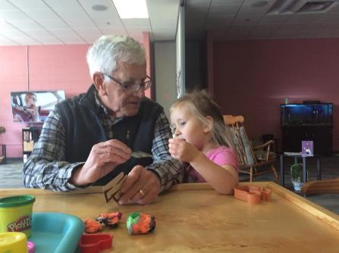
Challenges
Older Adults
Elder people present an increased risk of social isolation.
Social isolation is associated with a higher risk of hypertension, depression, cognitive decline, and even suicide
Fratiglioni, L., Wang, H. X., Ericsson, K., Maytan, M. and Winblad, B. (2000). Influence of social network on
occurrence of dementia: a community-based longitudinal study. Lancet London England, 355, 1315–1319. doi:10.1016/S0140-6736(00)02113-9
Gualano, M., Voglino, G., Bert, F., Thomas, R., Camussi, E., & Siliquini, R. (2018). The impact of intergenerational
programs on children and older adults: A review. International Psychogeriatrics,30(4), 451-468. doi:10.1017/S104161021700182X

Slide 6
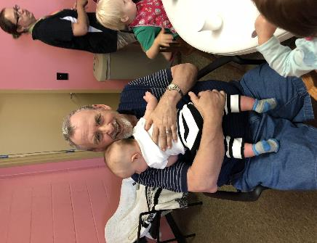
Impact on Older Adults
Lower incidence of depression.
Better Physical Health
Decreased risk of falls
Increase in a sense of usefulness and personal benefits
Significant increase on positive mood and behavior
Full engagement during one on one intergenerational activities
Improvement in food consumption.
Gualano, M., Voglino, G., Bert, F., Thomas, R., Camussi, E., & Siliquini, R. (2018). The impact of intergenerational programs on children and older
adults: A review. International Psychogeriatrics,30(4), 451-468. doi:10.1017/S104161021700182X
Freeman-Campbell, G. (2017, Jun 29). Live better -- intergenerational environments benefit elders. The Brandon Sun Retrieved from http://search.proquest.com.ezproxy.gvsu.edu/docview/1914684030?accountid=39473

Slide 7
Wilfrid Gordon McDonald Partridge
Written by: Mem Fox Illustrated by: Julie Vivas

Slide 8
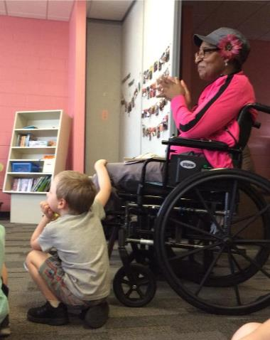
Impact on Children
Increased Social Maturity
Increase in positive descriptions to depict older adults.
Enhancement in personal/ social development.
Relief from the mental and physical stress
Knowledge of the older population improved
Improvement on children perception of the elderly
Improved Academic Outcomes
Gualano, M., Voglino, G., Bert, F., Thomas, R., Camussi, E., & Siliquini, R. (2018). The impact of intergenerational programs on children and older adults: A review. International Psychogeriatrics,30(4), 451-468. doi:10.1017/S104161021700182X
Freeman-Campbell, G. (2017, Jun 29). Live better -- intergenerational environments benefit elders. The Brandon Sun Retrieved from http://search.proquest.com.ezproxy.gvsu.edu/docview/1914684030?accountid=39473

Slide 9
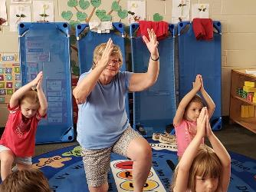
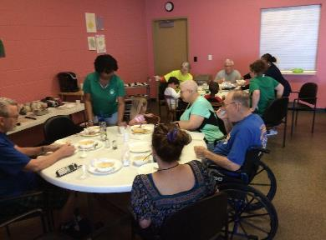
What a typical day looks like
The BIC is open from 6:30 am to 6:00 pm, Monday through Friday.
Activities, meals and snacks are part of both the children’s and older adult’s wings of The BIC.
Meals include breakfast, lunch and afternoon snack. We strive to supply nutritious, healthy and delicious foods prepared by our staff chef. We follow Child and Adult Care Food Program (CACFP)
Numerous activities are planned for children and seniors and some of them are designed to be intergenerational. We strive to provide an environment where real friendships built upon mutual respect are built between participants, staff and volunteers.

Slide 10
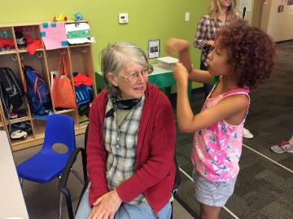
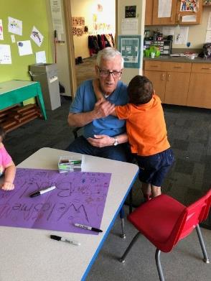
Magic of “Organic Interactions”
Greater Engagement & Purpose
Intergenerational relationships provide seniors with opportunities to grow, try new things, and help others. With their positive impact on youth is tangible, older adults feel validated, useful, respected, and needed. This cultivates confidence and a growing sense of self-worth in elders.
For children, their self-esteem and confidence grows with the attention and encouragement they experience from elders. Through meaningful interactions with other generations, children can find new opportunities to learn, explore, and feel good about themselves
Freeman-Campbell, G. (2017, Jun 29). Live better -- intergenerational environments benefit elders. The Brandon Sun Retrieved from http://search.proquest.com.ezproxy.gvsu.edu/docview/1914684030?accountid=39473

Slide 11
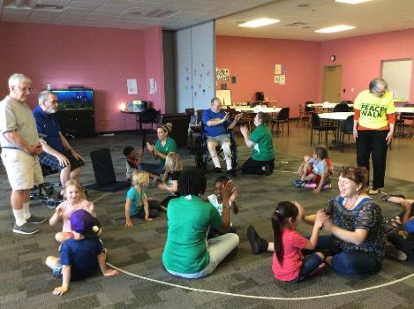
Music Together
The Bethlehem Intergenerational Center is a licensed Music Together (MT) Preschool Program. Music Together is an essential part of core curriculum. Classes are offered 1 day a week and taught by a trained MT teacher. The Music Together program provides children with the opportunity to learn music in developmentally appropriate ways:cognitive, emotional,social, and physical development.
Older adults who attend the BIC participate in MT classes. Whether sitting, standing, dancing, or singing, our participants are engaged and encouraged.

Slide 12
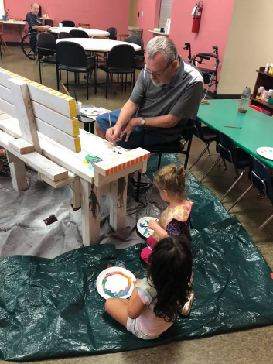
Intergenerational Events
Tuesday story time
Tasty Tuesday
Wednesday Music Together Classes
Music on the deck
Community field trips
Monthly birthday parties
Picture day
Grandparents day
Walk to End Alzheimer’s
Open House: Artprize at BIC
Muffins with Mom
Donuts with Dad
Valentine’s Day party
Halloween party/parade
Christmas program
Paws with a Cause
Blandford Nature Center Visit
Tailgates

Slide 13
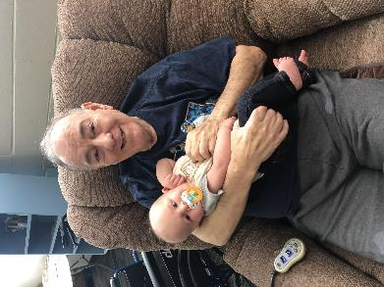
Keeping a Safe Environment
Older Adult Wing
Rose Room 60 years and older 40 participants enrolled
Early Childhood Wing
Green Room 4 year olds GSRP 16 child spaces
Red Room 3.5-5 years old Preschool 16 child spaces
Orange Room 2.5-3.5 years Young Preschool 14 child spaces
Blue Room 6 weeks- 2.5 years Infant/Toddler 8 child spaces

Slide 14
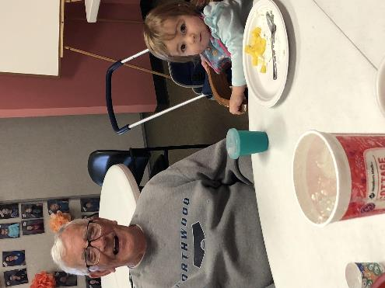
60 years + 1 staff to every 5 participants
3.5- 5 year olds 1 staff to every 10 children
(GSRP 1 staff to every 8 children)
2.5-3.5 1 staff to every 8 children
6 wks. – 2.5 1 staff to every 4 children
School Age 1 staff to every 15 children
Keeping a Safe Environment

Slide 15
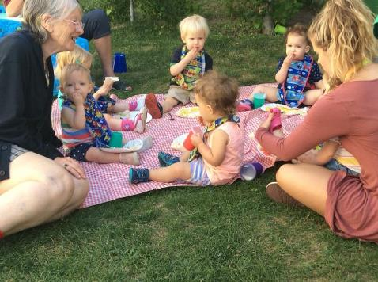
Financial Aid Options
Older Adult Wing:
Purchase of Service Provider for Area Agency of West Michigan (AAWM)
Respite Certificates through AAWM
Church Financial Aid Fund
Early Childhood Wing:
Tuition based child care
Great Start Readiness Program (GSRP) Preschool Program for 4 year olds, free preschool for those who qualify
Department of Human Services (DHS)
Bethlehem Church- tuition assistance program

Slide 16
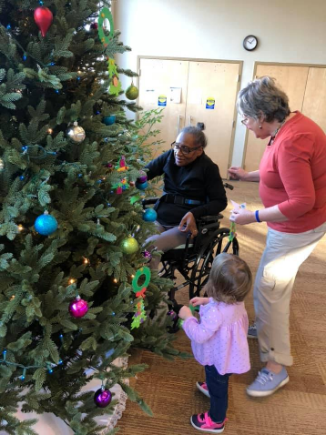
Transportation in Grand Rapids
RideLink
Ages 60 and older
$2.00 donation each way
Serves Kent County only
The Rapid- GoBus!
Must complete a “Proof of Age” application and submit accompanying documentation verifying applicants are aged 65 or older.
$3.50 each way
Senior Neighbors
Hope Network
Transportation can be covered by AAWM if a person meets the requirements.

Slide 17
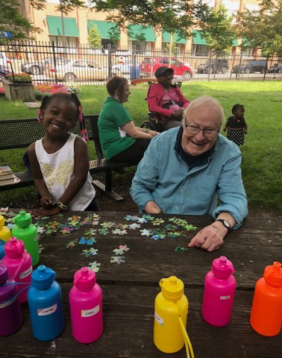
Outcomes
Aging in place
Respite care for caregivers
Maintain Independence for the older population
Relationship building/social skills
Reduce Caregiver Cost

Slide 18
250 Commerce Ave SW Grand Rapids, MI 49503
Open- Monday - Friday
6:30am-6:00pm
If you want to take a tour please call:
(616) 456-7509
Check us out on Facebook!

Slide 19
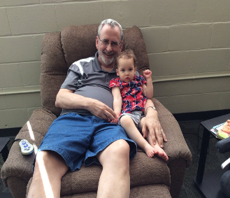
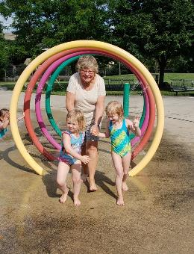
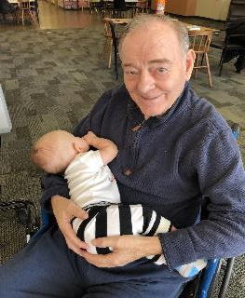
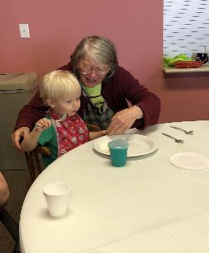
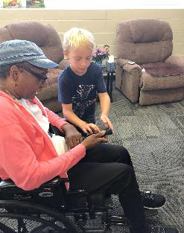
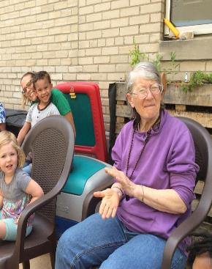
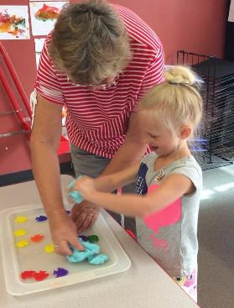
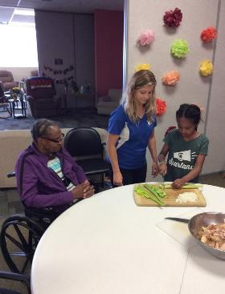
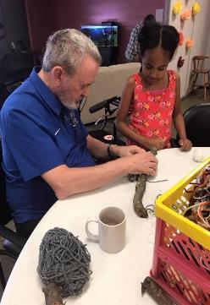
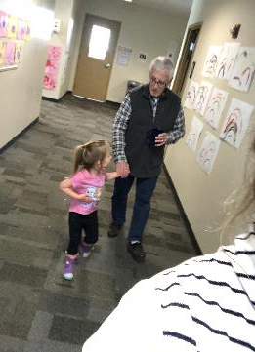
Meet Our Community

Slide 20
References
Flash, C. (2015). The intergenerational learning center, providence mount St. Vincent, Seattle, Journal of Intergenerational Relationships, 13(4),
338. doi:10.1080/15350770.2015.1105095
Murayama, Y., Ohba, H., Yasunaga, M., Nonak, K., Takeuchi, R., Nishi, M., . . . Fujiwara, Y. (2015). The effect of intergenerational programs on the
mental health of elderly adults, Aging & Mental Health, 19,306-314.
doi:10.1080/13607863.2014.933309
Sakurai, R., Yasunaga, M., Murayama, Y., Ohba, H., Nonak, K., Suzuki. H., Sakuma, N., Nishi, M., Uchida, H., Shinkai, S., Rebok, G. W., & Fujiwara, Y.
(2016). Long-term effects of an intergenerational program on functional capacity in older adults: results from a seven-year follow-up of the REPRINTS study, Archives of Gerontology & Geriatrics, 64, 13-20.
doi:10.1016/j.archger.2015.12.005.
Teater, B. (2016). Intergenerational programs to promote active aging: the experiences and perspectives of older adults, Act Adapt Aging, 40,
1-19. doi:10.1080/01924788.2016.1127041

