Slide 1
Sexy and Brainy: How Do They Go Together in Aging?
Jing Chen, PHD
Department of Psychology
Grand Valley State University

Slide 2
Outline
A brief review of the studies on changes in sexual activities in older adults
Relationships among sexual activities, cognitive functions, and aging
Possible paths of influences between sexual activities and cognitive functions
Neurogenesis
Dendritic density
Sex hormones

Slide 3
Life expectancy at birth is increasing:
Notes:
period life table (what happens to a hypothetical cohort that experience age-specific mortality rate from a particular period in time throughout their lives).
Life expectancy, estimate of the average number of additional years that a person of a given age can expect to live. The most common measure of life expectancy is life expectancy at birth. Life expectancy is a hypothetical measure. It assumes that the age-specific death rates for the year in question will apply throughout the lifetime of individuals born in that year. The estimate, in effect, projects the age-specific mortality(death) rates for a given period over the entire lifetime of the population born (or alive) during that time. The measure differs considerably by sex, age, race, and geographic location. Therefore, life expectancy is commonly given for specific categories, rather than for the population in general. For example, the life expectancy for white females in the United States who were born in 2003 is 80.4 years.
Life expectancy reflects local conditions. In less-developed countries, life expectancy at birth is relatively low, compared with more-developed countries. In some less-developed countries, life expectancy at birth may be lower than life expectancy at age 1, because of high infant mortality rates (commonly due to infectious disease or lack of access to a clean water supply).
Life expectancy is calculated by constructing a life table. A life table incorporates data on age-specific death rates for the population in question, which requires enumeration data for the number of people, and the number of deaths at each age for that population. Those numbers typically are derived from national census and vital statistics data, and from them the average life expectancy for each of the age groups within the population can be calculated.
The potential accuracy of estimated life expectancy depends on the completeness of the census and death data available for the population in question. The completeness of that data varies from country to country. In the United States, for example, official complete life tables based on registered deaths have been prepared since 1900, in connection with the decennial census. Since 1945, annual abridged U.S. life tables have been published based on the annual death registration and estimates of the population. Complete life tables show life expectancy for every year of age, and abridged tables show life expectancy for 5- or 10-year age groups, rather than for single-year groups. National life tables for many countries are published by the United Nations in its Demographic Yearbook.
Another life expectancy calculation is healthy life expectancy (or disability-free life expectancy), which is the average number of years a person is expected to live in good health, or without disability, given current age-specific mortality rates and disease and disability prevalence rates. Calculation of those figures requires reliable health statistics as well as mortality and census data.
https://www.britannica.com/science/life-expectancy

Slide 4
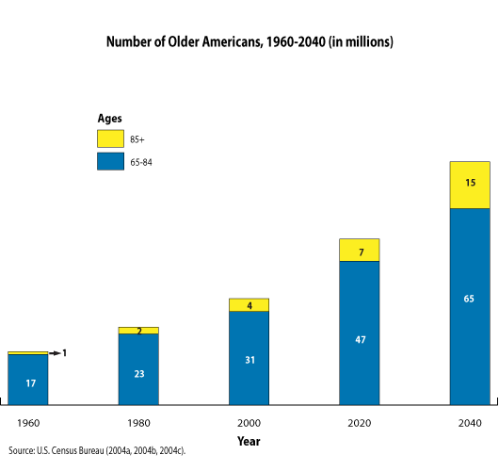
Older population is increasing rapidly:
26%
18%

Slide 5
Percentage of 65+ population across the world
Rank | Country | % of population over 65 years old
1 | Japan | 27
2 | Italy | 23
3 | Portugal | 22
4 | Germany | 21
5 | Finland | 21
6 | Bulgaria | 21
7 | Greece | 20
8 | Sweden | 20
Japan: By 2030 – 32.2%

Slide 6
Sexual activities in the older population
Sexual activity and relationships are still important part of older adults’ lives (e.g., Lindau et al., 2007; Lee et al., 2016)
% of respondents who were sexually active in previous year
In the US, A national probability sample N=3005 Total
N=1550 women
N=1455 men
Age range: 57-85 years
Lindau et al., 2007

Slide 7
% of people who are in a spousal or intimate relationship
In the US, A national probability sample N=3005 Total
N=1550 women
N=1455 men
Age range: 57-85 years
Lindau et al., 2007

Slide 8
% of people who are in a spousal or intimate relationship
In the US, A national probability sample N=3005 Total
N=1550 women
N=1455 men
Age range: 57-85 years
Lindau et al., 2007

Slide 9
Lindau et al., 2007
 | Respondents | Age Group |  |  | Self-Rated Health Status
 |  | 57-64 | 65-74 | 75-85 | Excellent Very Good | Good |  | Fair Poor
Sexual activity with a partner In previous 12 months
Men | N=1385 | 83.7 | 67.0 | 38.5 | 81.3 | 66.3 | 47.1
Women | N=1501 | 61.6 | 39.5 | 16.7 | 51.2 | 42.6 | 26.2
≥2-3 times per month
Men | N=857 | 67.5 | 65.4 | 54.2 | 72.5 | 61.6 | 46.4
Women | N=492 | 62.6 | 65.4 | 54.1 | 65.9 | 61.0 | 55.5

Slide 10
Reasons for Lack of Sexual Activity among Survey Respondents Who Had Not Had Sex during the Previous 3 Months
Reason | Respondents with Spousal or Intimate Relationship |  |  | Respondents without Spousal or Intimate Relationship
Age | 57-64 | 65-74 | 75-85 | 57-64 | 65-74 | 75-85
Lack of interest in sex—%
Men | 13.5 | 11.7 | 19.1 | 18.3 | 22.0 | 32.1
Women | 23.8 | 25.0 | 24.9 | 43.0 | 47.0 | 60.3
Partner not interested in sex—%
Men | 29.5 | 10.3 | 16.8
Women | 19.2 | 19.8 | 15.8
Physical health problems or limitations—%
Men | 40.3 | 56.6 | 61.4 | 27.4 | 15.7 | 28.3
Women | 16.8 | 16.7 | 24.8 | 9.2 | 4.4 | 4.7
Partner’s physical health problems or limitations—%
Men | 20.1 | 31.3 | 22.7
Women | 63.2 | 63.4 | 64.8
Lindau et al., 2007

Slide 11
A study of community-dwelling older postmenopausal women
N= 1235, Age: 60-89 (Mean=73.6)
53% were married or in an intimate relationship.
 | 60-69 (n=389) | 70-79 (n=565) | 80-89(n=281)
Sexual Activity
Has sex been a part of your life in the last 6 months, either with or without a partner?
Yes | 51.7 | 32.6 | 13.5
No | 39.3 | 50.6 | 61.9
Missing | 9 | 16.8 | 24.6
Reasons for sex not being a part of your life in the last 6 months
Not interested | 13.8 | 11.5 | 13.2
Do not have a partner | 39.2 | 40.1 | 52.3
Thompson et al., 2011

Slide 12
Thompson et al., 2011

Slide 13
The English Longitudinal Study of Ageing
Lee, Nazroo, O’Connor, Blake, & Pendleton, 2016
Age group (years)
Men | All ages | 50-59 | 60-69 | 70-79 | 80 to >90
Any sexual activity in the past year
All | 77.7 | 94.1 | 84.5 | 59.3 | 31.1
Living with a partner | 80.3 | 96.3 | 86.4 | 60.6 | 37.0
Not living with a partner | 70.5 | 89.0 | 77.7 | 54.5 | 22.3
Thinking about sex frequently | 80.2 | 95.0 | 84.7 | 65.7 | 38.7
Frequent sexual intercourse
All | 48.5 | 59.6 | 44.2 | 32.8 | 19.0
Frequent kissing, fondling, or petting
All | 63.6 | 68.4 | 62.0 | 57.1 | 48.6
Frequent masturbation | 44.3 | 54.0 | 41.1 | 30.4 | 16.7
Erectile difficulties | 39.2 | 15.5 | 35.5 | 66.1 | 88.3
Difficulty achieving orgasm | 15.6 | 8.3 | 14.9 | 33.2 | 52.2
Compared with a year ago decreased…
Level of sexual drive/desire | 32.3 | 24.2 | 30.1 | 42.6 | 49.1
Frequency of sexual activities | 36.8 | 35.9 | 34.6 | 42.9 | 42.3
Ability to have an erection | 23.8 | 16.5 | 24.9 | 36.8 | 47.2

Slide 14
The English Longitudinal Study of Ageing
Lee, Nazroo, O’Connor, Blake, & Pendleton, 2016
Women | Age group (years)
 | All ages | 50-59 | 60-69 | 70-79 | 80 to >90
Any sexual activity in the past year
All | 53.7 | 75.9 | 59.9 | 34.3 | 14.2
Living with a partner | 69.9 | 86.1 | 69.6 | 48.3 | 41.1
Not living with a partner | 30.4 | 57.6 | 36.8 | 16.8 | 3.7
Thinking about sex frequently | 45.5 | 69.4 | 48.4 | 25.4 | 10.4
Frequent sexual intercourse | 50.1 | 59.1 | 44.9 | 35.7 | 31.6
Frequent kissing, fondling, or petting | 67.7 | 72.8 | 64.7 | 58.6 | 61.5
Frequent masturbation | 15.9 | 20.4 | 13.1 | 9.2 | 7.0
Difficulties becoming sexually aroused | 32.3 | 24.5 | 37.6 | 51.0 | 34.6
Difficulty achieving orgasm | 27.1 | 23.4 | 30.6 | 32.1 | 34.1
Dry vagina during sexual activity | 19.1 | 13.3 | 25.0 | 30.3 | 12.6
Pain during/after sexual activity | 10.1 | 8.4 | 11.6 | 14.5 | 6.2
Compared with a year ago decreased…
Level of sexual drive/desire | 33.0 | 33.1 | 29.9 | 35.5 | 36.4
Frequency of sexual activities | 39.2 | 38.0 | 37.9 | 44.3 | 48.1
Ability to become sexually aroused | 26.6 | 25.2 | 27.4 | 28.0 | 36.3

Slide 15
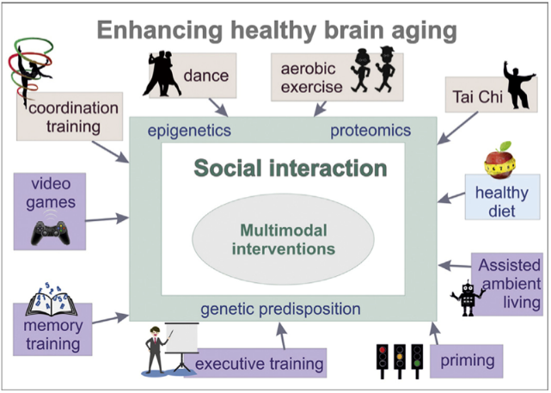
Ballesterosa, S., Kraftb, E., & Tzirakid, C (2015). Maintaining older brain functionality: A targeted review. Neuroscience and Biobehavioral Reviews, 55, 453–477.

Slide 16
Sexual activity is a rewarding social interaction that might offer some protection against cognitive decline in older adulthood (Opendak, Briones, & Gould, 2016; Paredes, 2009)
Ballesterosa, S., Kraftb, E., & Tzirakid, C (2015). Maintaining older brain functionality: A targeted review. Neuroscience and Biobehavioral Reviews, 55, 453–477.

Slide 17
Satisfaction with overall sex life
Positively associated with SF-36 mental health and SRQL
Negatively associated with CES-Depression
Sexual activity was positively associated with
SRSA
SRQL
Thompson et al., 2011

Slide 18
Any Impact on Cognitive Functions?

Slide 19
Studies do show that there seem to be a correlation between sexual activities and cognitive function in older adults
2016
2017
2018
2018

Slide 20
Earlier studies
2014
2013

Slide 21
The Wave 6 English Longitudinal Study of Ageing (ELSA)
N = 6,833 Men=3060 Woman=3773
Ages: 50-89 years
Wright & Jenks, 2016

Slide 22
The Wave 6 English Longitudinal Study of Ageing (ELSA)
N = 6,833 Men=3060 Woman=3773
Ages: 50-89 years
Wright & Jenks, 2016

Slide 23
Wright & Jenks, 2016
Covariates:
Age
Education
Wealth
Physical activity
Depression
Cohabiting
Self-rated health
Loneliness
Quality of life
Sexual activity significantly correlated with
Men:
Number sequencing and Recall
Women:
Recall but not Number sequencing

Slide 24
Wright, Jenks, & Demeyere (2017)
In a much smaller sample,
N=73
Ages: 50-83, 61.6% female
Greater frequency of sexual activity predicts:
Better total ACE-II
Verbal fluency
Visuospatial ability

Slide 25
A prospective study on sexual activity, emotional closeness, and cognitive decline, Allen, 2018
N = 6016 (2672 men, 3344 women, Age average=66 years)
T2-T1 = 2 years
 | Mean Scores | r (Women) | r (Men)
Sexual activity | 2.08
Memory performance, T1 | 11.23 | .26 | .20
Emotional closeness | 4.36 | .30 | .18
Physical activity | 2.71 | .22 | .26
Diet | 5.12 | .11 | .03
Sleep quality | 8.01 | -.08 | -.15
Television viewing | 37.66 | -.14 | -.15
Current smoking | 11.8% | -.05 | -.03
Past smoking | 62% | -.05 | -.12
Alcohol | 4.28 | -.17 | -.18
Memory Performance, T2 | 10.79 | .19 | .27
2018

Slide 26
A US Nationally representative study of home-dwelling older Adults
Lindau et al., 2018
 | Normal |  | MCI |  | Dementia
 | Men N=814 | Women N=938 | Men N=436 | Women N=429 | Men N=264 | Women N=315
Age
62-69 | 66.5 | 75.4 | 26.1 | 16.6 | 7.4 | 8.0
70-79 | 57.8 | 59.2 | 27.4 | 25.5 | 14.8 | 15.3
80-91 | 38.3 | 37.2 | 32.1 | 31.9 | 29.6 | 30.9
Education
<HS | 20.5 | 23 | 36 | 29.1 | 43.5 | 48
>=BA | 79 | 82.4 | 16.8 | 14.4 | 4.1 | 3.2
Marital Status
Married | 60.7 | 69.3 | 27 | 21.7 | 12.4 | 9.0
Very Good | 67 | 69.1 | 24.2 | 21 | 8.8 | 9.9

Slide 27
A US Nationally representative study of home-dwelling older Adults Lindau et al., 2018
 | Normal |  | MCI |  | Dementia
 | Men N=814 | Women N=938 | Men N=436 | Women N=429 | Men N=264 | Women N=315
Self Rated Physical Health
Poor or Fair | 42.3 | 45.7 | 32 | 23 | 25.7 | 31.3
Good | 58.7 | 56.9 | 28.7 | 27.8 | 12.7 | 15.3
Very Good | 66.6 | 74.3 | 24.6 | 19.4 | 8.8 | 6.3
Self Rated Mental Health
Poor or Fair | 45.4 | 42 | 28.2 | 25.7 | 26.4 | 32.3
Good | 44.2 | 55.7 | 34.7 | 25.5 | 21.1 | 18.8
Very Good | 67 | 69.1 | 24.2 | 21 | 8.8 | 9.9
Depression
Yes | 41.3 | 51.2 | 31.7 | 22.8 | 27.1 | 26
No | 61 | 64.4 | 27 | 23.1 | 12 | 12.5

Slide 28
A US Nationally representative study of home-dwelling older Adults
Lindau et al., 2018
 | N | Normal | MCI | Dementia
Sexual activity with partner in previous 12 months
Men | 1450 | 66.7 | 55.7 | 45.5
Women | 1625 | 40.1 | 31.5 | 17.6
>=2-3 times per Months
Men | 799 | 61.1 | 60 | 59.2
Women | 543 | 65.1 | 51.9 | 57.4

Slide 29
Correlation
Causation
It is possible:
Sexual activities
Cognitive functions
It is also possible:
Cognitive functions
Sexual activities
And many other possibilities
Covariates such as: general health

Slide 30
Sexual activities
Cognitive functions
Cognitive functions
Sexual activities

Slide 31
Exploring the possible mechanisms underlying the influence of sexual activities on cognitive functions
Can sexual activities have impacts on the brain structures underlying important cognitive functions?
What about sexual hormones on neuronal functions?

Slide 32
We do know about aerobic exercises:
Erickson, et al., 2011

Slide 33
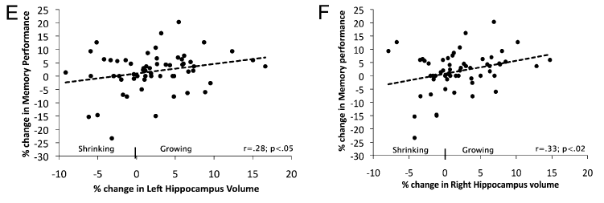
Hippocampal volume and cell proliferation
Hippocampal volume and spatial memory
Erickson, et al., 2011

Slide 34
A variety of social experiences can impact adult neurogenesis in the hippocampus
Opendak, Briones, & Gould, 2016

Slide 35
Neurogenesis in human adult brain
Eriksson et al., 1998 – study of cancer patients

Slide 36
Kempermann et al. (2018) reviewed the evidence for human adult neurogenesis

Slide 37
The Olfactory Bulb:

Slide 38
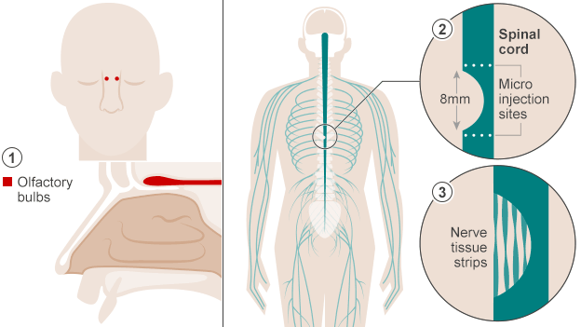
Raisman et al., 2014 – Cell Transplant
40 years old paralyzed man walks again after cell transplant

Slide 39
Cell proliferation:
Cell survival:
Two processes involved in neurogenesis
Prickaerts et al., 2004

Slide 40
Praag, Kempermann, & Gage, 1999
One Day After
Four Weeks After

Slide 41
Effects of a single session of sexual experience on Neurogenesis
Kim et al., 2013

Slide 42
Effects of repeated daily sexual activity (five days) on neurogenesis
Kim et al., 2013

Slide 43
Sexual activity, Stress, and Neurogenesis
Kim et al., 2013

Slide 44
3 weeks of sexual activity and stress on hippocampal cell survival
Kim et al., 2013

Slide 45
Retention Memory after a delay of 90 Minutes, 1 and 2 days
Kim et al., 2013

Slide 46
A single bout of sexual experience was sufficient to increase cell proliferation in the dentate gyrus despite elevated Corticosterone level
Leuner, Glasper, Gould (2010)

Slide 47
Leuner, Glasper, Gould (2010)
Chronic sexual experience produced more new neurons in dentate gyrus
Higher level of cell proliferation
Not higher level of corticosterone
The increased number of proliferating cells in sexually-experienced rats was confirmed using the endogenous marker of cell proliferation, Ki67.

Slide 48
Sexual experience alters dendritic morphology
Leuner, Glasper, Gould (2010)
Sexual experience alters dendritic spine density
Dendritic length
Dendritic Branching

Slide 49
Sexual experience reduces some measures of anxiety-like behavior
Compared to naive controls, sexual experience reduced anxiety-like behavior indicated by a shorter latency to consume a familiar food in a novel environment.
Leuner, Glasper, Gould (2010)

Slide 50
Cell proliferation in the Olfactory Bulb
Corona et al., 2016

Slide 51
Cell proliferation in the Olfactory Bulb
Corona et al., 2016

Slide 52
Cell survival in the Olfactory Bulb 45 days after
One stimulation either olfactory or mating, was not enough to modify the survival rate of new cells that reach the Olfactory Bulb.
Corona et al., 2016

Slide 53
The medial prefrontal cortex
Sexual experience and dendritic density in medial prefrontal cortex
Male rats were house in the same cage with sexually-receptive and non-receptive female for 7 consecutive days.
Performance on each stage of discrimination in the attentional set-shifting task.
Sexual experience group was significantly better at
the extradimensional shift task (EDS).
Glasper, LaMarca, Bocarsly, Fasolino, Opendak, & Gould, 2015

Slide 54
Sexual experience selectively increases dendritic spine density

Slide 55
Sex Hormones
Estrogens and androgens may have neuroprotective effects (Simerly et al., 1990).
The hippocampus and the surrounding regions have high density of androgen receptors (Holland, Bandelow, & Hogervorst, 2011).
Testosterone may modulate neuronal damage cause by oxidative stress (Ahlbom, Prins, & Ceccatelli, 2001) as well as reduce neuronal apoptosis or self programmed cell death (Hammond et al., 2001).
Oxidative stress and neuronal apoptosis may play an important role in both AD and age-related cognitive decline (Holland et al., 2011)
Low testosterone level is considered to be a risk factor for pathological changes associated with cognitive decline in AD.

Slide 56
Boss, Kang, Marcus, & Bergstrom (2014) conducted a systematic review of endogenous sex hormones and cognitive function in older adults:
26 studies from 1997-2012 were included
Estradiol levels may benefit episodic memory, semantic memory, verbal, and verbal learning in females only.
The relationship between testosterone and cognitive function was mixed in both genders.

Slide 57
Testosterone levels and cognition in elderly men
Holland, Bandelow, & Hogervorst, 2011
The relationship between testosterone levels and cognitive functions may not be linear.
There may be age dependent optimal testosterone levels that vary for different brain functions.
Optimal testosterone levels to maintain cognition may be related to age and the type of cognitive function.
Positve associations have been found between testosterone levels
and global cognition, memory, executive functions and spatial performance in observational studies.
However, non-significant associations were also reported. It may be that an optimal level of testosterone
exists at which some cognitive functions are improved. This may be modified with an older age, with a
shifting of the optimal testosterone curve to maintain cognition to the left and a lower optimal level thus
needed to be beneficial for the brain.

Slide 58
Oxytocin has been linked to social behaviors such as mating and parenting (Neumann, 2009; Young & Wang, 2004).
Micro-infusions of Oxytocin in one hemisphere and saline in the other
Leuner, Caponiti, & Gould, 2012

Slide 59
Oxytocin enhances cortical information transfer while lowing background activity
Owen et al., 2001

Slide 60
Questions Remain
From animal models to human behaviors
Adulthood versus Older adulthood
From basic research to practice

Slide 61
A lot of thinking and a lot of research are needed!

