Slide 1
for Individuals with ASD and other Complex Disabilities
START: Statewide Autism
Resources and Training

Slide 2
The Problem Increase in Referrals Sexual Assault / Abuse Aberrant Sexual Behaviors Sexual Crimes

Slide 3
Gathering Information
Terri Couwenhoven, AASECT Sex Educator (tcouwen@execpc.com). Sexuality Issues in Students with I/DD: Boundaries and Behavior. Presented December 16, 2015 Kent ISD.
Isabelle Henault, Author & Sex Therapists, University of Quebec – 2 Trainings in Collaboration with Oakland University.
Selected research articles and books (references included in this presentation)
Current laws related to sexual health education for ALL students

Slide 5
Health Education in Michigan
Michigan adheres to the Michigan Model for Health K-12 curriculum that addresses social / emotional health; nutrition / physical activity; alcohol, tobacco and other drugs; and safety.
School districts are also required to teach about dangerous communicable diseases, including, but not limited to, HIV/AIDS at least once a year at every building level (elementary, middle/junior, senior high).
School districts can choose to teach sex education. If they do, they must do so in accordance with those sections of the Michigan Compiled Laws (MCL) related to sex education and reproductive health.

Slide 6
Many Students with ASD Excluded
Exchanged for SpEd Classes / Resource
Not Included in Self-Contained Curriculum

Slide 7
Sex Education is a Local BOARD Decision in Michigan
Purpose is to protect and promote health and to provide skills needed for caring, safe, and responsible relationships.
Sound programs address human development, healthy relationships, possible consequences of sexual risk behaviors, influence of alcohol and other drugs on decisions, and sexuality within society and culture.
Instruction should emphasize that students have the power to control personal behavior and should base their actions on reasoning, a sense of responsibility, and respect for self and others
Education programs should address the needs of all students--those who abstain from sexual activity, those who have engaged in sexual activity but are currently abstaining, and those who may currently be engaging in sexual behaviors.
Programs should be developmentally, linguistically, culturally, and age-appropriate and of sufficient duration for students to acquire the knowledge and skills needed to adopt healthy behaviors.

Slide 8
WHO CAN TEACH SEX EDUCATION
Those qualified to teach Health including endorsements of MA (health), MX (health, physical education, recreation and dance combined), or KH (family and consumer science).
Biology or life science teachers continue to be qualified by their endorsements to teach those aspects of reproductive health that are detailed in the K-12 Science Standards. Local education agencies may define these classes as sexuality education classes for the purpose of review by the Sex Education Advisory Board, as detailed in Section 380.1507 of the Revised School Code.
Special education teachers who teach sexuality education in self-contained settings are qualified on the successful completion of in-service training in sexuality education that is relevant to the developmental needs of their students.

Slide 9
Even if the district offers education in Sexual Health, many students with ASD are not receiving it because it is believed it is not relevant or the work is not differentiated enough for their meaningful participation

Slide 10
Myth Busters
Asexual
Oversexed
Developmentally too young
Have higher / aberrant needs / interests
Experience puberty later
Lack capacity to form relationships
Sex education will result in increased sexual interest and activity
OTHERS?

Slide 11
Making the Case for Sexual Health Education
OVER-PROTECTION
AVOID the Topic (FEAR)
LESS Education
Find Inappropriate Information
Make MORE Abuse** / Mistakes
PROTECTION
Issues on the Table
Specialized EDUCATION
Access to APPROPRIATE Materials
Address Mistakes / Prevent Abuse
**Stranger Danger

Slide 12
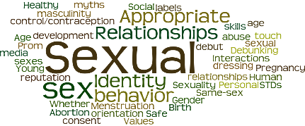
TREATMENT / THERAPY
SEXUAL HEALTH EDUCATION
Bodies & Boundaries
Privacy
Social Skills
Relationships
Personal Limits
Consent
Safety & Exploitation Prevention
How To of Sexual Behaviors
Aberrant Sexual Behavior

Slide 13
Not an Endorsement
Lack of Research
Many More

Slide 14
The Need for Specialized Sexual Health Education for Students with ASD
Theory of Mind Challenges (Frank Sinatra Syndrome “My Way”)
Consent – she didn’t SAY “no”
Reactions and Corrections of Peers (Where / When)
Peers know the social code

Slide 15
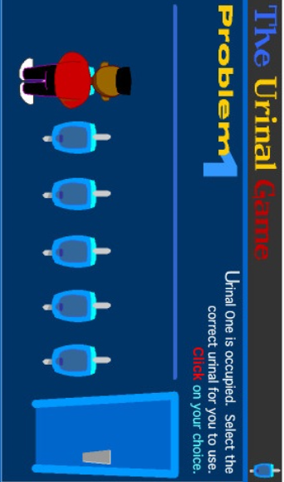
The Urinal Game

Slide 16
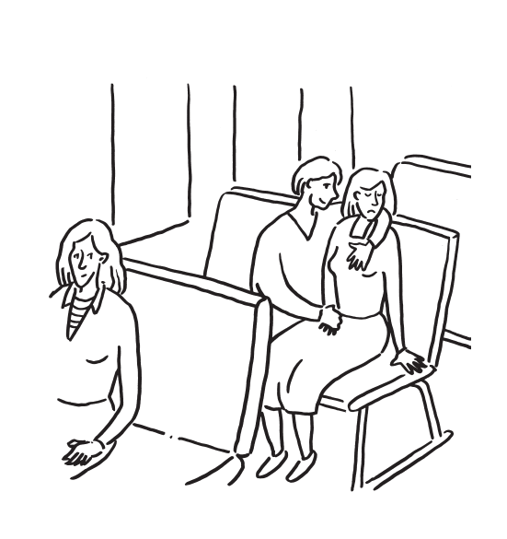
Thinking, Saying & Feeling Bubbles
SAYING
THINKING
FEELING

Slide 18
The Need for Specialized Sexual Health Education for Students with ASD
Theory of Mind Challenges (Frank Sinatra Syndrome “My Way”)
Consent – she didn’t SAY “no”
Reactions and Corrections of Peers (Where / When)
Peers know the social code
Concrete Thinking
Sexual Assault = Intercourse
“How do I know if I’m gay?”

Slide 19
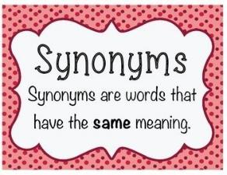
Concrete Thinking: Sexual Language
– Formal/Polite: Vagina, Penis
– Technical: Labia, Scrotum
– Slang: Dick, Muffin
– Cute: Va‐jay‐jay, krull the warrior king

Slide 20
The Need for Specialized Sexual Health Education for Students with ASD
Theory of Mind Challenges (Frank Sinatra Syndrome “My Way”)
Consent – she didn’t SAY “no”
Reactions and Corrections of Peers (Where / When)
Peers know the social code
Concrete Thinking
Sexual Assault = Intercourse
“How do I know if I’m gay?”
Misperceptions
Private vs Public Place
Private – Alone?

Slide 21
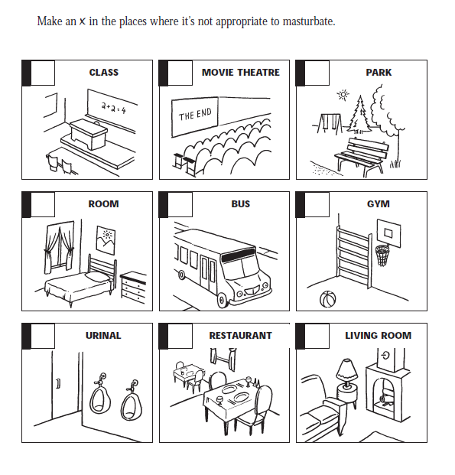

Slide 22
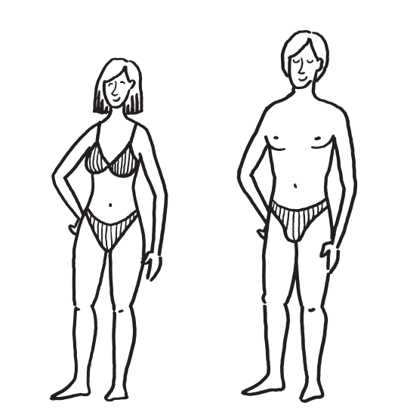
Private Body Parts

Slide 23
Puberty & Sexuality Concerns for Individuals on the Autism Spectrum Jam Page, Autism Specialist

Slide 24
The Need for Specialized Sexual Health Education for Students with ASD
Theory of Mind Challenges (Frank Sinatra Syndrome “My Way”)
Consent – she didn’t SAY “no”
Reactions and Corrections of Peers (Where / When)
Peers know the social code
Concrete Thinking
Sexual Assault = Intercourse
Misperceptions
Private vs Public Place
Private – Alone?
Sexual Exploitation / Abuse
Social Media
70% some type of abuse
Altered Scripts for Sexual Learning

Slide 25
Altered Scripts for Sexual Learning
Negativity / Discomfort
Reactions of Staff (“no”)
Myths of Oversexed
“Love Shack” – 1 (TV); 2 (Cook) 3 (Sex)—perceived 3
Reliance on Adults for Self-Care Needs
Privacy
Altered Living Environment
More closely monitored
Dressing / using restroom in front of others
Isolation & Loneliness
Lack of opportunity and consenting partner
Mean age for Typical? ASD?

Slide 26
Altered Scripts for Sexual Learning Internet and Porn
Look out of Curiosity
Body Parts
How to have sex
Misunderstanding of Typical
Genital Hair (non existent or shaved)
Notion of Consent (no means no?)
Genital Size
Juvenile Porn
Misjudge age—views self as less mature
Illegal? -- “I didn’t pay for it” so it must be legal
Predators
SAFE SEARCH FILTERS

Slide 28
Specialization for Students with ASD
Accurate Information / Understandable Level / Simple Explanations / Concrete Examples
Developmental Age (HOW); Chronological Age (WHAT)
TEACH from the POSITIVE
Teach to the community norm (parent survey – be transparent about need and what is being taught)
Begin with Most IMMEDIATE NEED (social appropriate)
CONSENT (Green, Yellow, Red)
“Make Wise Choices”
5 Point Scales
Legal / Illegal
5 is Against the Law
Appropriate Behaviors based on Relationships

Slide 29
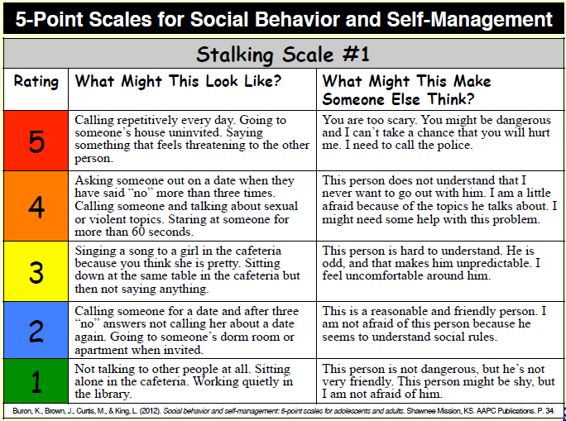
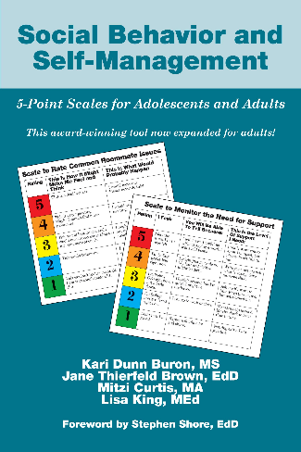

Slide 30
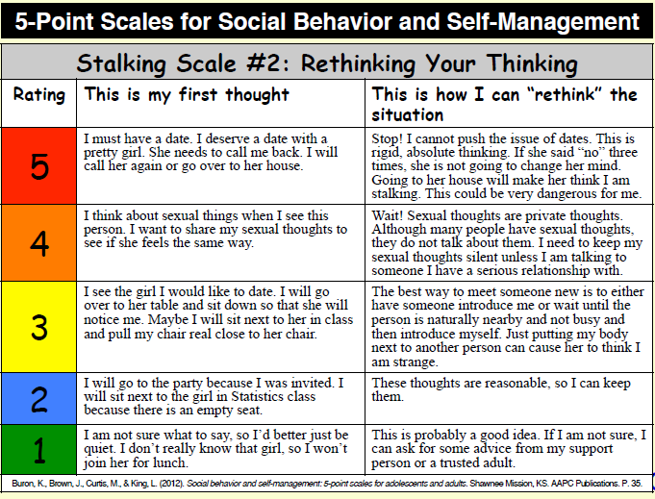
Steven Shore
http://www.autismasperger.net/

Slide 31
Aberrant Sexual Behavior
Most Common?
Different than what people THINK is most common
Masturbation:
Over / Under Stimulation
Public vs. private (bedroom, door closed) understanding
If excessive, likely not successful (meds / wrong gesture) -- thrusting
Normal peak puberty 1-5x per day
Medication Effects
OTHER?

Slide 32
Staff Learning Modules Dave Hingsburger @ http://www.openfuturelearning.org/index.html

Slide 33
Nila Benito Florida Center for Inclusive Communities & DD Council
Parent Guide:
http://www.fddc.org/sites/default/files/file/publications/Sexuality%20Guide-Parents-English.pdf
Educators Guide: http://flfcic.fmhi.usf.edu/docs/Educator_LowRes_English.pdf

Slide 34
Terri Couwenhoven, M.S. https://terricouwenhoven.com/

Slide 35
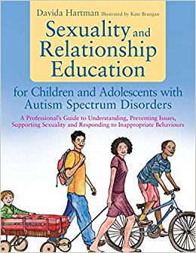
Child Checklist

Slide 36
https://www.elevatustraining.com/
NOTE: This training is supported by the Michigan DD Council as part of their ongoing support for sexual health education for those with DD.

Slide 37
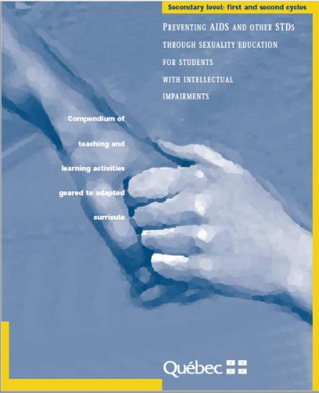
http://publications.msss.gouv.qc.ca/msss/fichiers/2000/00-309A.pdf

Slide 38
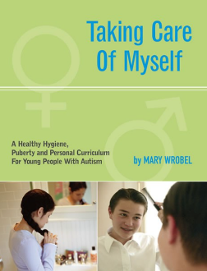

Slide 39
FLASH Curriculum / Lessons
http://www.kingcounty.gov/depts/health/locations/family-planning/education/FLASH/special-education.aspx
https://www.stanfield.com/product/life-horizons-curriculum-bundle-w1033d/

Slide 40
https://www.etr.org/store/curricula/

Slide 41
http://www.pubertycurriculum.com/
http://teachers.teachingsexualhealth.ca/
http://www.stanfield.com/product/circles-curriculum-bundle-w1037-3/

Slide 42
Finding My Way Through
Dating and Relationships
Puberty Resources / Period
Safe Sex Practices
Protecting Myself from Pregnancy and STDs
Same Sex Series
Rule Cards

Slide 43
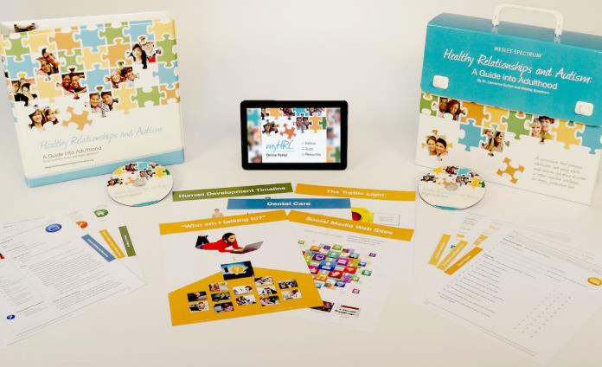
Healthy Relationships Curriculum http://healthyrelationshipscurriculum.org/

Slide 44
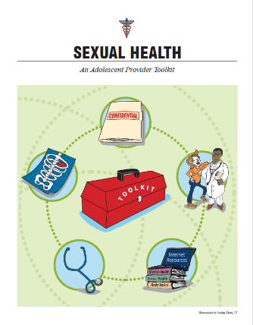
Autism Speaks Health Tool Kit https://www.autismspeaks.org/sites/default/files/documents/transition/health.pdf
ATN Puberty Resources
UCSF
https://partnerships.ucsf.edu/sites/partnerships.ucsf.edu/files/images/SexualHealthToolkit2010BW.pdf
http://vkc.mc.vanderbilt.edu/healthybodies/

Slide 45
SPARK: Talking about the Birds and the Bees in ASD
https://sparkforautism.org/webinars/?utm_source=newsletter&utm_medium=email&utm_campaign=Mar18_newsletter_past_webinars

Slide 46
Additional Resources / Curriculum Examples / Process for Curriculum Approval Resources for Families (Health Education Passport)

Slide 47
Current ACTION Sexual Health Representatives to the RCN
Participate in Sexual Health COP:
Develop and Inform the START Sexual Health for Students with ASD Module
Inform legislation to ensure that first offenders with ASD would be sentenced to education, not punishment;
Family focus and resources;
Collaboration with clinics providing therapy in sexual health
Present the Sexual Health for Students with ASD Module 2+ times per year in their region

Slide 48
Current ACTION
Partner w/ Regional school health coordinators – typically housed at ISD / RESA providing training / TA to local districts on HIV and sex education – meet needs of Ss w/Dx
Support administration of parent survey (instrument example) to determine what topics parents want taught at specific grade levels
Within RCN / ISDs – determine which districts have approved sexual health education.
For those who do, access curriculum materials / resources and identify contacts on the Sex Education Advisory Board (SEAB) (required) – this group can help with approval for a more explicit curriculum for students with disabilities, if needed.
For those who do not, present module to assist district leadership in understanding the need and moving forward on approving a curriculum for students with disabilities.

Slide 49
Additional References
Chan, J. & John, R.M. (2012). Sexuality and Sexual Health in Children and Adolescents with Autism. The Journal for Nurse Practitioners, 8(4).
Davis, T.N. et.al. (2016). A Review and Treatment Selection Model for Individuals with Developmental Disabilities Who Engage in Inappropriate Sexual Behavior. Behavioral Analysis Practice, 9, 389-402.
Gerhardt, P.F. (2013). Puberty, Sexuality, & Adaptive Behavior with Learners with Autism Spectrum Disorders. The McCarton School. (www.mccartonschool.org).
Riggs Cohen, M. (2011). ASD and Internet Crime. Asperger Center for Education & Training.
Tullis, C.A. & Zangrillo, A.N. (2013). Sexuality Education for Adolescents and Adults with Autism Spectrum Disorders. Psychology in the Schools, 50(9).
Travers, J. & Tincani, M. (2010). Sexuality Education for Individuals with Autism Spectrum Disorders: Critical Issues and Decision Making Guidelines. Education and Training in Autism and Developmental Disabilities, 45(2), 284-293.

