Slide 1

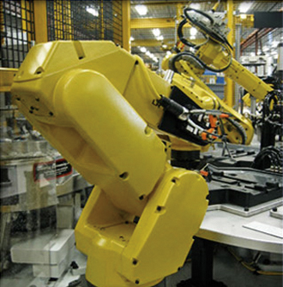

Padnos College of
Engineering & Computing
Industry
Collaboration Opportunities
Breeann Gorham Chris Babbitt
Associate Director Assistant Director
gorhamb@gvsu.edu babbitc1@gvsu.edu
331.6708 331.6708

Slide 2
GVSU Facts
Established in 1960
Campuses in Allendale and Grand Rapids
Liberal Education Foundation
3,280 Faculty and Staff
81 Undergraduate Programs
29 Graduate programs
200+ Areas of Study
25,094 Students
  21,636 Undergraduate
  3,458 Graduate
$20-25 Million annual scholarly funding
State of MI SBDC
DeVos Center for Entrepreneurship & Innovation

Slide 3
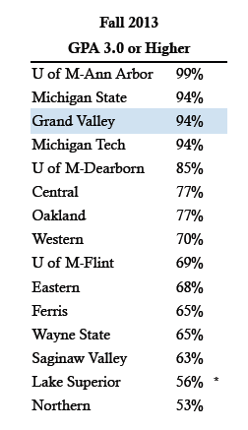
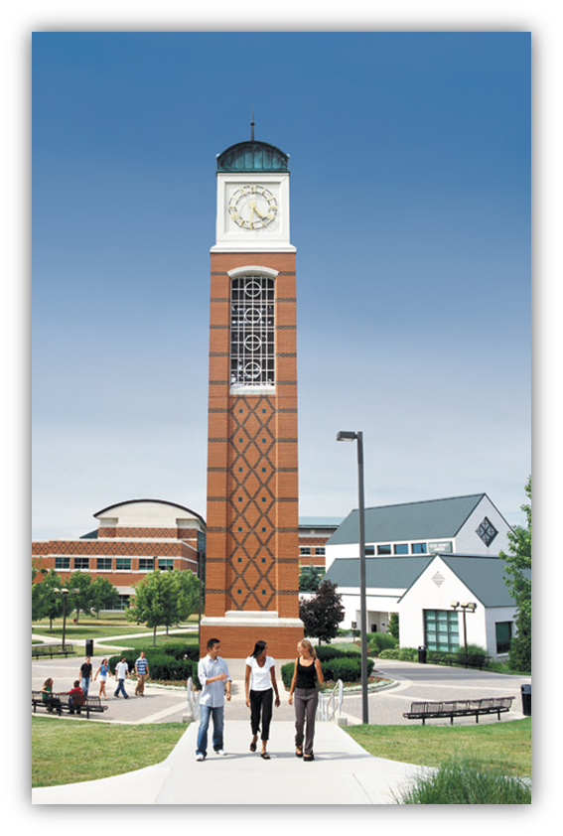
% of Entering Students with GPA ≥ 3.0

Slide 4
GVSU Recognitions
2014 College of the Year
(Educate to College)
One of America’s Best Colleges (6 years in a row, US News & World Report)
One of America’s 100 Best College Buys (4th Year - Forbes Magazine)
#2 Up and Coming Regional University in the Midwest & 3rd Among Top Public Regional Universities in the Midwest
(US News & World Report)
One of the Best Universities in the Midwest (The Princeton Review)
Overall College Sustainability Leader (College Sustainability Report Card 2011)
Michigan’s Number 1 Green University (The Princeton Review)

Slide 5
Padnos College Recognitions
School of CIS named #1 Best College for the Money in the US (by College Factual)
School of Engineering featured for best practices in student retention and success
(American Society for Engineering Education)
Named as an “Exemplar of Real World Engineering Education” (National Academy of Engineering)
One of the top 50 undergraduate engineering programs in the US (US News & World Report)
1st Place in two Innovation competitions in 2014
1st Place in Undergrad and Grad categories in 2015 Green Light Michigan Innovation Competition

Slide 6
Padnos College
Undergraduate Programs
School of Engineering
Computer Engineering 111
Electrical Engineering 190
Mechanical Engineering 595
Product Design & Manufacturing Engineering 153
Interdisciplinary Engineering 63
Undecided 48
Subtotal 1,160
School of Computing & Information Systems
Computer Science 417
Information Systems 196
Subtotal 613
Department of Occupational Safety and Health (OSH)
OSH Management 62
Total Undergraduate Majors 1,835
Fall 2014

Slide 7
Padnos College
Graduate Programs
School of Engineering
Biomedical Engineering 19
Electrical & Computer Engineering 34
Mechanical Engineering 14
Product Design & Manufacturing Engineering 14
Production Operations 4
Subtotal 85
School of Computing & Information Systems
Computer Inform. Systems 78
Medical & Bio-Informatics 18
Subtotal 96
Total Graduate Majors 174
Fall 2014

Slide 8
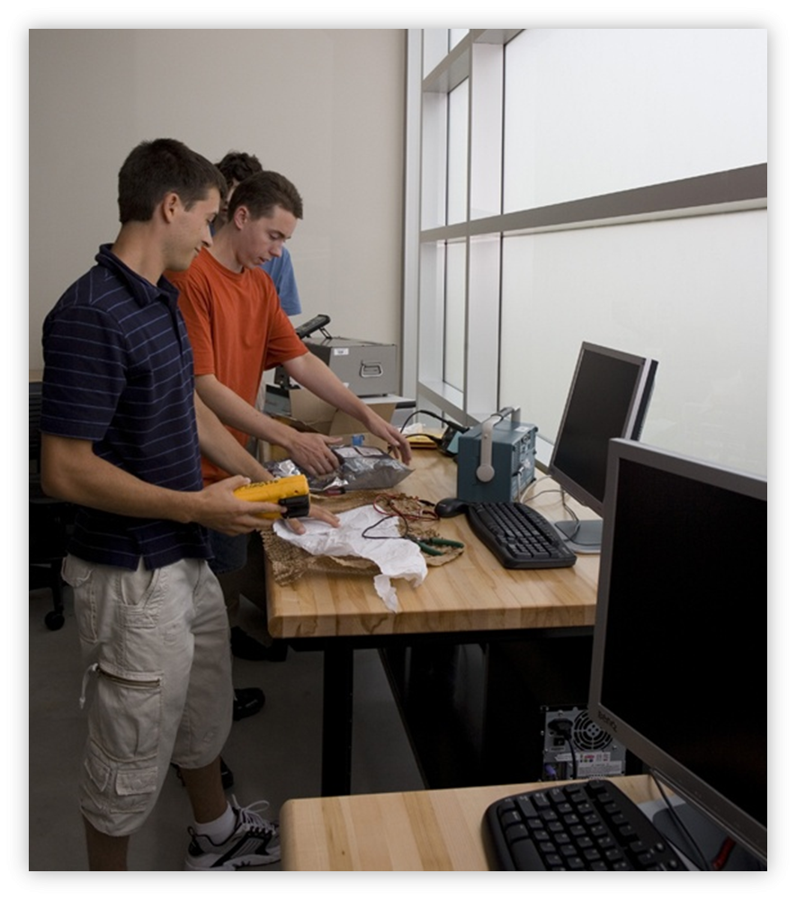
Padnos College
Programs Distinguishing Features
Extensive Labs and Projects
Over 90,000 sq-ft of Industrial-Grade Facilities
Course & Consultancy Projects for Industry
Industry Based Capstone (BS & MS)
Real Corporate Problems
Multi-Disciplinary Teams
Design, Build, Test, Delivery
Integrated Practical Training
Engineering Co-op
Computing Internships
OSH Internships

Slide 9
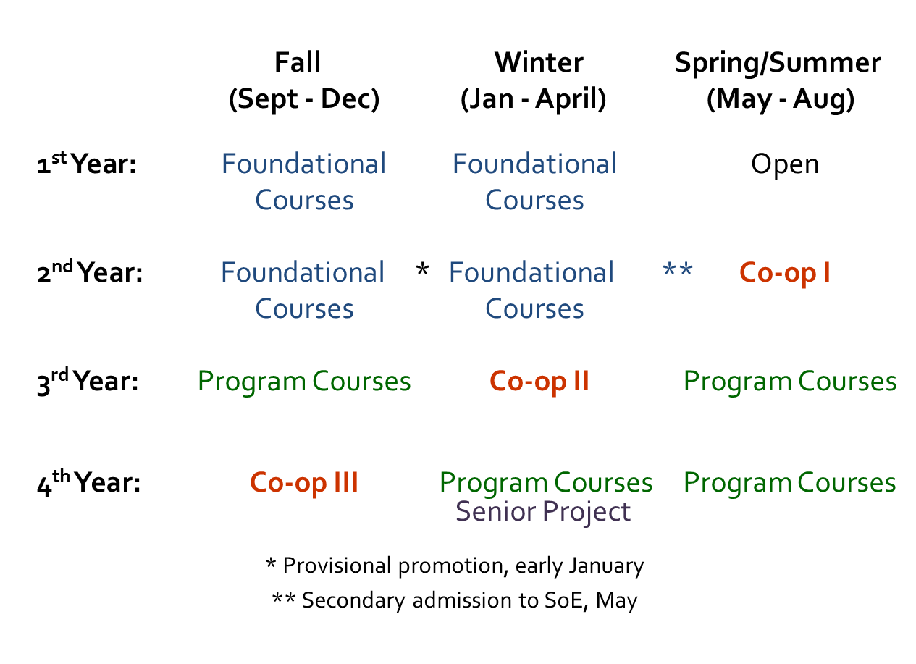
Co-op Program Plan

Slide 10
Co-op Program Requirements
Foundational courses completed:
  Calculus sequence (4X), Physics (2X), Chemistry, Engineering Design/Build including CAD/CAM & Computer Programming (2x), Engineering Laboratory work including Statistics and Writing, Statics & Solid Mechanics, Materials Science, Digital Systems, Circuit Analysis, and Co-op Preparation
  Minimum GPA of 2.7 and grade of 2.0 (“C”) in each foundational course
Practice interview feedback
Essay – “Why I Want to Become an Engineer”

Slide 11
Co-op Program Features
Admitted to SoE
Co-op during junior and senior years
Alternating semesters
Summer semester start
One full-time year of work
Students working all semesters
  (not just summers)
May work anywhere
(domestic and international)

Slide 12
Co-op Program Expectations
Student
  Good attitude and hard work
  Written/web homework and weekly journal
Company
  Degreed engineers supervise and mentor student
  Progressively responsible engineering work
Faculty
  Support/assess each student, every semester
All
  Evaluations
  Three semesters with the same company

Slide 13
Co-op Keys to Success
Develop aggressive learning goals with the student
Provide responsible, challenging work related to the above goals
Progressively grow the student from “apprentice” to “entry-level” engineer

Slide 14
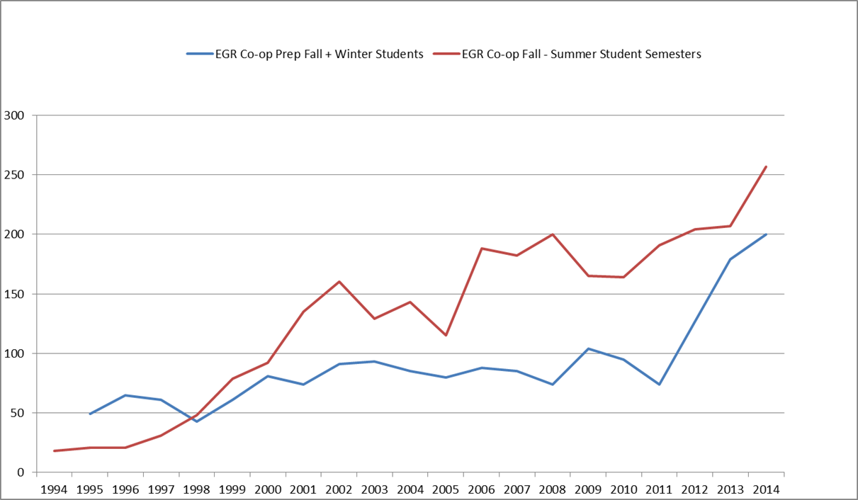
Co-op Growth Over 20 Years

Slide 15
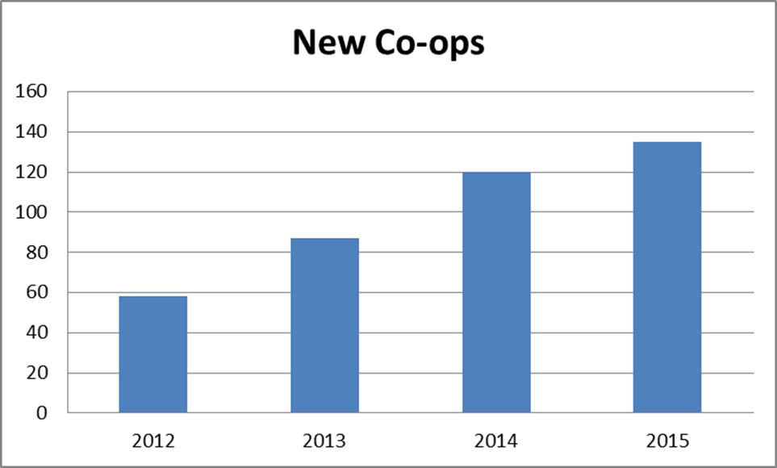
Growth in Enrollment in First Co-op Semester

Slide 16
Co-op Recruiting Dates
Oct 5-8: Practice Interviews
Oct 22: GVSU Fall Career Fair
  Pre-approval by SoE (≥ 3.2 GPA)
Dec 31: LakerJobs Co-op Postings
Jan 9: Approval by SoE
Jan 20: Co-op Recruiting Fair
Anytime: Interviews/Provisional Offers

Slide 17
Co-op Updates
Experiential Learning Restrictions
(6 States)
  Georgia, Kentucky, Maine, New Hampshire,
  New York, and North Carolina
  Hire in Michigan, can be sent anywhere

Slide 18
Co-op Updates
Affordable Care
  Students ≤ 26 should use parents’ policy
  Even with two semesters, it’s less than 30 hours/week for the year
Average Co-op Pay Rates
  Summer 2013: $14.13
  Winter 2014: $14.79
  Fall 2014: $15.25

Slide 19
CIS Internships
Required by all CS & IS majors after reaching Junior status
Minimum 16 hours / week for one Semester (can work more hours)
Offered all Semesters (fall, winter & summer)
May begin prior to the Semester of Academic Credit & extend beyond

Slide 20
OSH Internships
Required for all OSH Majors typically in summer between the junior and senior years
Minimum of 300 hours for 3 credits (half-summer) and 600 hours (full summer) for 6 credits
Can extend over one or more semesters
May be done in any semester

Slide 21
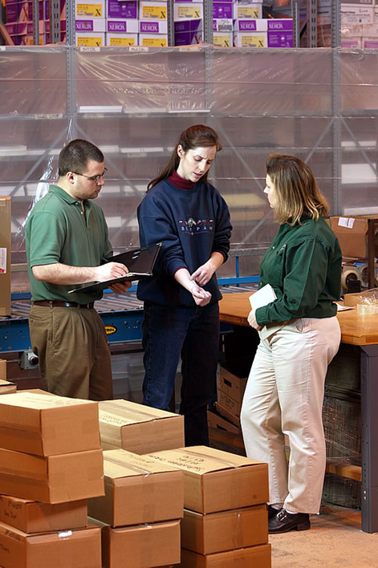
OSH Internship Requirements
Student
  Engage in multiple aspects of the OSH profession
  Electronic Portfolio – Updated weekly
Company
  OSH professionals supervise Student
  Provide a broad experience in OSH profession
  Evaluation
Professors
  Evaluate Student’s Progress Each Semester

Slide 22
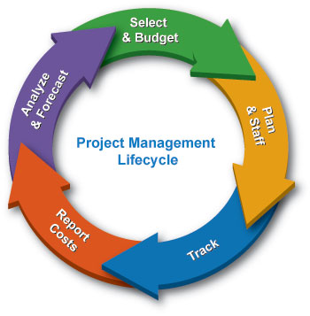
2014 Senior Projects
10 Sponsors
10 Projects

Slide 23
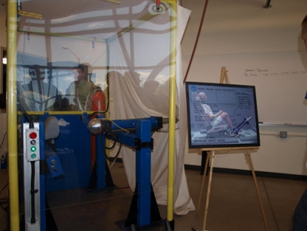
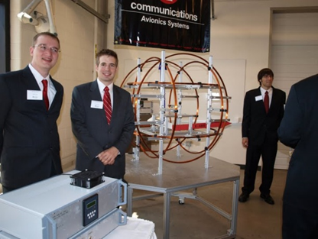
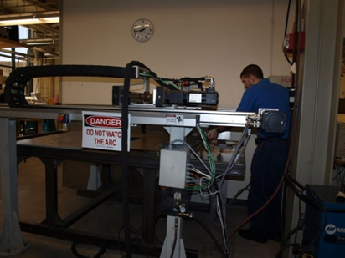
2014 Senior Projects Statistics
10 Projects
Total materials costs approximately $120K
Collectively, nearly $3 million invested in materials by local industry through this program

Slide 24
Senior Project “Samples”
Bissell Home Care Inc
Automated Fill and Drain System For Steam Cleaners
Testing bed
DornerWorks LLC
Search and Rescue Imaging Module
Autocam
Multi-Spindle Machine Automation
Fulton Innovation
Wireless Power 3D Mouse
Gill Industries, Inc.
Independent Electric Drive and Suspension for a Golf Car
Gentex
Automated mold release application system

Slide 25
Senior Project Program Timeline
August to November
  Projects proposed
December
  Notification of project acceptance
January
  Projects assigned to the students
January to March
  Student teams form & prepare design proposals, including budgets and schedule
March to July
  Students present design to sponsor, receive approval, complete design, purchase materials, build, debug, test, & qualify device

Slide 26
Padnos College GA & IGF Programs
Graduate Assistantships
  Competitive
  Several Available
  Tuition + Stipend
Industrial Graduate Fellows
A graduate student gains work experience at company (20 hours/week in the fall and winter semester and 40 hours/week in the summer)
  MS Student Gains Experience in a Company
  Company supports Tuition (to GVSU) and Internship Wages (to Student)
  Workplace Project as Graduate Thesis / Project
  Employment Opportunities
  Mutually Beneficial for Student, Company & University “W³”

Slide 27
IGF Key Benefits to the Employer
A top notch engineer in the team for about 66% of the work-year at a fraction of cost
World’s longest interview
Participation in selecting the right candidate from a world-wide pool
Potential permanent employee with a graduate degree in engineering

Slide 28

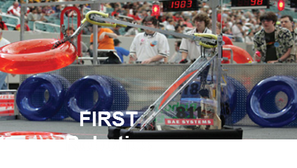





K-12 Outreach Activities

