Slide 1
Welcome to PRIME+
Year 4: Day 2
January 15, 2015
Notes:
Upon entry, teachers should have received their focus book, “5 Practices for Orchestrating Productive Mathematical Discussions”.

Slide 2
Welcome to DAY 2!
Facilitators: Rusty Anderson & Chelsea Ridge
GVSU M/S Center Director: Karen Meyers
Program Coordinators: Carolyn Siebers, Roger Verhey
Project Evaluator: Fredi Frost
Notes:
Housekeeping:

Slide 3

HOUSEKEEPING
Welcome
Parking Pass
Agenda
After School Meetings Protocol
Notes:
Housekeeping:
Address any SCECH issues,
Discuss materials to be given (to new people)
Discuss necessary evaluations

Slide 4
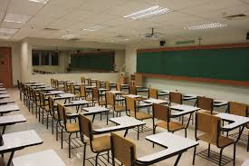
Pretend you are in a traditional classroom with rows
Work on the yellow cross multiplication worksheet.
How is this a NON-Example of the 5 Practices?
PLEASE TAKE
A SEAT
Notes:
Housekeeping:
Address any SCECH issues,
Discuss materials to be given (to new people)
Discuss necessary evaluations

Slide 5

Mathematically Powerful?
What are we doing differently?

Slide 6
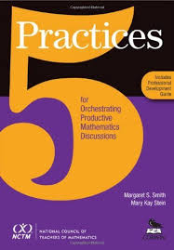
5 PRACTICE RUBRIC
Notes:
DEVELOP 5 PRACTICE RUBRIC
Group participants according to number (1-15)
Assign one of the 5 Practices to each group.
Describe what a “0” and “3” would look like for the assigned Practice.
Compare with other groups with the same Practice.
Discuss whole group.

Slide 7
5 PRACTICE RUBRIC
In your groups:
Describe what a
“0” and “3” would
look like for the
assigned Practice.

Slide 8
5 PRACTICE RUBRIC
In your groups:
Compare with other groups with the
same Practice.

Slide 9

MATH CHALLENGE
Using the cross product worksheet from the non-example activity, how could you transform the lesson to Level 3 in terms of the 5 Practices?

Slide 10

Break

Slide 11

5 PRACTICE RUBRIC
In your groups:
Describe what a “0” and “3” would look like for the assigned Practice.
Compare with other groups with the same Practice.
SELECTING AND SEQUENCING
Circles and Squares
Notes:
CIRCLES AND SQUARES TASK
Mars Mapshell
Focus: Selecting and Sequencing
Group participants according to letter (A-O)
Solve task in as many ways as possible.
Discuss strategies.
Select and sequence student work - may also use work from discussion with participants. Why did you choose this sample? Why did you not choose the other samples?
Ask participants to select and sequence using a different strategy. May refer to 5 Practices book for ideas on how to select and sequence in a different way.
Discuss.

Slide 12

SELECTING AND SEQUENCING
Solve task in as many ways as possible.
5 PRACTICE RUBRIC
In your groups:
Describe what a “0” and “3” would look like for the assigned Practice.
Compare with other groups with the same Practice.
Circles and Squares
Notes:
CIRCLES AND SQUARES TASK
Mars Mapshell
Focus: Selecting and Sequencing
Group participants according to letter (A-O)
Solve task in as many ways as possible.
Discuss strategies.
Select and sequence student work - may also use work from discussion with participants. Why did you choose this sample? Why did you not choose the other samples?
Ask participants to select and sequence using a different strategy. May refer to 5 Practices book for ideas on how to select and sequence in a different way.
Discuss.

Slide 13
SELECTING AND SEQUENCING
Select and sequence student work.
You may also use work from our discussion.
**Keep in mind our goal is proportional reasoning**
5 PRACTICE RUBRIC
In your groups:
Describe what a “0” and “3” would look like for the assigned Practice.
Compare with other groups with the same Practice.
Circles and Squares
Notes:
CIRCLES AND SQUARES TASK
Mars Mapshell
Focus: Selecting and Sequencing
Group participants according to letter (A-O)
Solve task in as many ways as possible.
Discuss strategies.
Select and sequence student work - may also use work from discussion with participants. Why did you choose this sample? Why did you not choose the other samples?
Ask participants to select and sequence using a different strategy. May refer to 5 Practices book for ideas on how to select and sequence in a different way.
Discuss.

Slide 14
SELECTING AND SEQUENCING
Select and sequence using a different strategy.
Refer to 5 Practices book for ideas on how to select and sequence in a different way.
5 PRACTICE RUBRIC
In your groups:
Describe what a “0” and “3” would look like for the assigned Practice.
Compare with other groups with the same Practice.
Circles and Squares
Notes:
CIRCLES AND SQUARES TASK
Mars Mapshell
Focus: Selecting and Sequencing
Group participants according to letter (A-O)
Solve task in as many ways as possible.
Discuss strategies.
Select and sequence student work - may also use work from discussion with participants. Why did you choose this sample? Why did you not choose the other samples?
Ask participants to select and sequence using a different strategy. May refer to 5 Practices book for ideas on how to select and sequence in a different way.
Discuss.

Slide 15
SELECTING AND SEQUENCING
    Why did you choose this sample?
    Why did you NOT choose the other samples?
5 PRACTICE RUBRIC
In your groups:
Describe what a “0” and “3” would look like for the assigned Practice.
Compare with other groups with the same Practice.
Circles and Squares
Notes:
CIRCLES AND SQUARES TASK
Mars Mapshell
Focus: Selecting and Sequencing
Group participants according to letter (A-O)
Solve task in as many ways as possible.
Discuss strategies.
Select and sequence student work - may also use work from discussion with participants. Why did you choose this sample? Why did you not choose the other samples?
Ask participants to select and sequence using a different strategy. May refer to 5 Practices book for ideas on how to select and sequence in a different way.
Discuss.

Slide 16
Discussion on Principles for Action
Teaching and Learning Survey

Slide 17
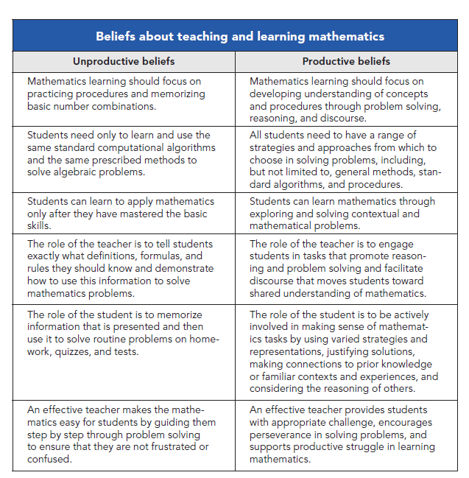

Slide 18
Logistics for Day 5

Slide 19
Keep In Mind
In groups of 4 or 5, with at least 2 districts represented
Choose a date between the March and April Session
Teach at a school of your choosing, all teachers will meet at that school for your 5th session
Must use 6 hours of lesson analysis excluding lunch
Working with the Kent ISD Learning Lab
Research Lesson – the focus is on improvement of the lesson to make the content more accessible through the use of the 5 Practices.

Slide 20


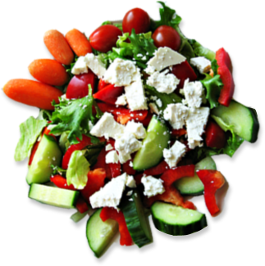
Lunch Break
11:30am – 12:15pm

Slide 21
Math Challenge…

Slide 22
Imagine that you were able to take a string and wrap it around the earth at the equator . . .

Slide 23
Next, remove the string and add one additional meter of string to it.

Slide 24
Take the lengthened string and wrap it around the earth again.

Slide 25
What animal would fit between the surface of the earth and the string?

Slide 26
Imagine that you were able to take a string and wrap it around the earth at the equator . . .
Next, remove the string and add one additional meter of string to it.
Take the lengthened string and wrap it around the earth again.
What animal would fit between the surface of the earth and the string?

Slide 27

Notes:
What animal would fit under the string?
https://www.polleverywhere.com/free_text_polls/iHkVCzuwPeHGkeV

Slide 28
Proportional Reasoning
Does this activity relate to proportional reasoning?
Does this activity blend well with the 5 Practices?
Does this activity utilize the 8 Mathematical Practices from the CCSS?

Slide 29
5 PRACTICE RUBRIC
In your groups:
Describe what a
“1” and “2” would
look like for the
assigned Practice.

Slide 30

Give me a <br>

Slide 31

Selecting Your Team

Slide 32

In what ways is proportional thinking evident in your class?
Create a mini lesson you can teach in your class before next session
where student thinking will be evident.
Notes:
Set a Goal
What is one goal you would like to set for yourself from now to the next session?
Share at tables.
Discuss as a group.

Slide 33
Evaluations
PRIME+
Thank you for your participation!
Day 3
February 9th, 2015 PERE MARQUETTE ROOM
Notes:
Re

