Slide 1

THERE AREN’T ENOUGH LEADERS IN YOUR ORGANIZATION
JEREMY PAUL & ALICEN FIMPLE

Slide 2

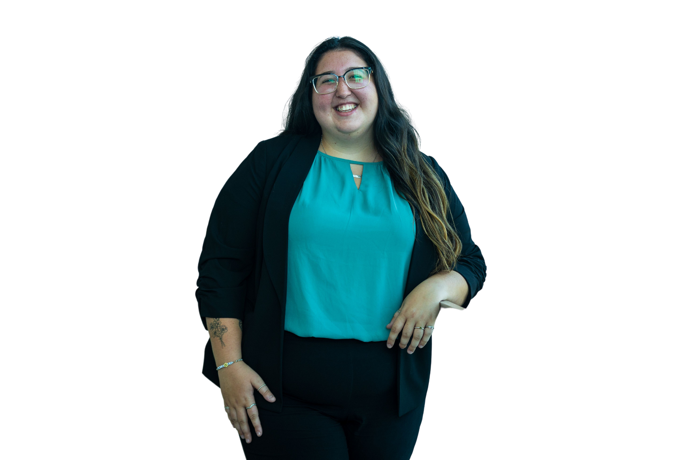
LEADERSHIP DEVELOPMENT STAFF
Jeremy Paul
Assistant Director of Student Life
He/Him/His
Alicen Fimple
Student Life Specialist
She/Her/Hers

Slide 3

WHAT IS LEADERSHIP?

Slide 4


STRONGLY
AGREE
AGREE
STRONGLY
DISAGREE
DISAGREE

Slide 5
STRONGLY
AGREE
AGREE
My organization uses
leadership opportunities as
a selling point for membership
STRONGLY
DISAGREE
DISAGREE

Slide 6
STRONGLY
AGREE
AGREE
My organization is
underpromising on what
it is selling
STRONGLY
DISAGREE
DISAGREE

Slide 7
STRONGLY
AGREE
AGREE
My organization is prepared
to provide robust membership
development programs to
our members
STRONGLY
DISAGREE
DISAGREE

Slide 8
STRONGLY
AGREE
AGREE
Grand Valley provides enough
accessible opportunities for ALL
students to be a part of leadership
development programs
STRONGLY
DISAGREE
DISAGREE

Slide 9

ARE YOU READY TO
SAIL?

Slide 10
DEVELOPING YOUR LEADERSHIP TOOLBOX
Leading With Your Strengths
February 26 from 4-5:30 p.m.
Discovering Your True Colors in Leadership
Crafting Your Leadership Mission
March 11 from 4-5:30 p.m.
March 18 from 4-5:30 p.m.

Slide 11

Leading With
Your Strengths
Facilitated By: Jeremy Paul

Slide 12

Discovering Your True Colors
Facilitated By: Abby Sachs

Slide 13

Crafting Your Leadership Mission
Facilitated By: Alicen Fimple

Slide 14
2024 LEADERSHIP SUMMIT
Friday, April 5
12 - 6 p.m.
Grand River Room

Slide 15
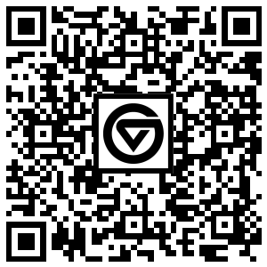
Focus of Content Areas:
  Civic Engagement
  General Leadership
  Personal Development
  Professional Development
  Social Justice
  Student Organizations
REGISTER
NOW

Slide 16
What Leadership Development programming would you like to see?

Slide 17

THANK YOU!
Questions?
Please complete this survey!

