Slide 1
1. RECENT JOB/INTERNSHP OPENINGS | New week, new opportunities to learn and grow as an HTM professional. Check out the listings for jobs and internships!
2. INTERNATIONAL WINE, BEER, & FOOD FESTIVAL | The Festival is the top fundraising event for the HTM Club, so the more people we have sign-up to volunteer the more money for ALL HTM STUDENTS! You also get to experience working a large event in a convention center. Sign up to volunteer!
3. VOLUNTEER: TEACH-IN | Student volunteers needed for this year’s Teach-In. The purpose of Teach-In is for mutual education among students, faculty and staff and is intended to address topics related to inequality and systems of oppression, as well as social justice and liberation. Volunteer either for the Pew Campus or Allendale.
4. IMPORTANT STUDENT RESOURCES | This semester the weekly announcements will feature a helpful campus resources for students to utilize. ! If you have a resource that you would like to share with the GVSU HTM community, feel free to email rydzewki@gvsu.edu to share on the weekly announcements.
5. ACTIVITIES AROUND GRAND RAPIDS | Weekend highlights: Three days of Grand Rapids Comic Con at the Devos Place. And start your holiday shopping at the Made Market at the Goei Center.
11.11.2024
Click here to learn more about all GVSU HTM opportunities available to you

Slide 2
New Internship and Employment Opportunities
Food & Beverage Team Lead | Wings Event Center
Greenleaf Hospitality - Kalamazoo, Michigan
Application Deadline: 12/5/2024 Posted: 11/5/24
Service Agent
Home2 Suites Grand Rapids North - Grand Rapids, Michigan
Application Deadline: 12/31/2024 Posted: 10/23/24
Events Intern
Meadow Brook Hall - Rochester, Michigan
Application Deadline: 3/1/25 Posted: 10/17/24
1

Slide 3
INTERNATIONAL WINE, BEER, & FOOD FESTIVAL VOLUNTEERS
The Grand Rapids Wine, Beer and Food Festival will be taking place November 22 & 23, at DeVos Place Convention Center and we need your help!
This is our top fundraiser for the HTM Club each year, and the more people we get to sign up the more money we make, which allows them to do fun things for ALL HTM students!
In addition to the fundraising, it is a great opportunity to work a huge event in the convention center, work with a winery and learn about what they serve, get experience pouring, working with the public, and networking!
2
SIGN UP HERE!
When you sign up, select GRAND VALLEY STATE UNIVERSITY HOSPITALTY & TOURISM as the nonprofit group so we can track accurate payment. TIPS training will be offered for all pouring volunteers.

Slide 4
VOLUNTEER OPPORTUNITY
3
Volunteers are needed for the Teach-In either Wednesday, Nov. 13 on the Pew Campus or Thursday, Nov. 14 in Allendale.
Building/Registration and Volunteer table Greeter: greet and direct people to schedule sessions, answer guest questions and assist with other items as needed
Setup: unload and set supplies for rooms/registration tables, post signs, test computer for volume/microphone and Meeting OWL
Tear down: gather supplies from rooms/registration tables, signs, Meeting OWL and put away to-go containers
Sign Up Here to Volunteer!

Slide 5
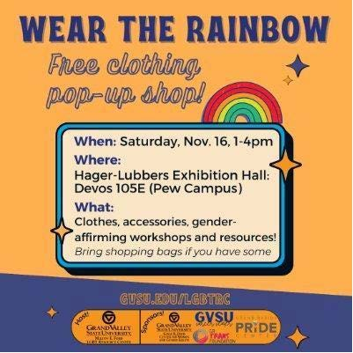
IMPORTANT STUDENT RESOURCES
It is important that all students are given the resources they need to thrive here at GVSU. Learn more about the resources available to you on campus, many of which are available to students at NO COST.
Available Resources Include: Academics, Academic Support, Belonging and Campus Climate, Campus Safety, Finances, and Wellness
Saturday, November 16, 1-4 PM
Join the GVSU LGBT Resource Center for a free clothing pop-up shop and workshops. Bring a shopping bag for your choices! Pew Campus, Devos 105E.

Slide 6
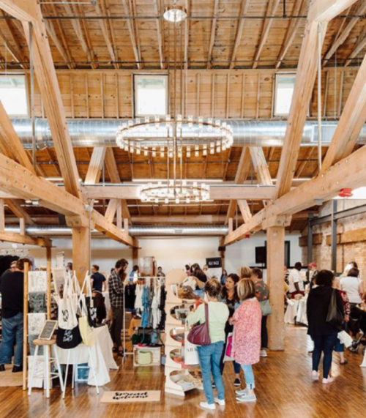
GRAND RAPIDS EVENTS
5
MADE MARKET
Holiday Market
November 16, 2024
Goei Center 818 Butterworth St SW Grand Rapids, MI 49504
Grand Rapids Comic Con
November 15-17, 2024
The Devos Place
303 Monroe Ave NW
Grand Rapids, MI 49503

