Slide 1
1. RECENT JOB/INTERNSHP OPENINGS | New week, new opportunities to learn and grow as an HTM professional. Check out the listings for jobs and internships!
2. INTERNATIONAL WINE, BEER, & FOOD FESTIVAL | Now in its 17th year, this Festival has established itself as Michigan’s annual tasting event, measured by more than 1,200 wines, beers, ciders and spirits from around the world, along with creations from the area’s finest restaurants. Volunteer opportunities will be available to contribute to the HTM Club.
3. SUMMER INTERNSHIP | Summer internship opportunity in Northwest Florida. 12-week internship at a vacation rental business with one-on-one training, job shadowing, and guaranteed housing.
4. WORLD OF WINTER VOLUNTEERS | Volunteer at the World of Winter outdoor festival with activities like the silent disco and the painting tables. The festival includes outdoor light installations and activities most of which are free to attend.
5. WORK ABROAD EVENT | If you are interested in working abroad after graduation, the Padnos International Center is hosting a work abroad event at the Kirkhof. Learn about the different job opportunities from the Padnos staff.
6. INDIGI-FEST | Come meet your Indigenous sovereign neighbors at the Indigi-Fest. Programming includes a language workshop, discussion on food sovereignty, and an introduction to Powwow.
11.18.2024
Click here to learn more about all GVSU HTM opportunities available to you

Slide 2
New Internship and Employment Opportunities
Summer Internship
ScenicStays - Destin, Florida
Application Deadline: 3/1/25 Posted: 11/14/24
Dishwasher/Steward, Kalamazoo Country Club | FT
Greenleaf Hospitality - Kalamazoo, Michigan
Application Deadline: 12/12/2024 Posted: 11/13/24
Buffet Attendant / Prep Cook - The Morning Dish
Greenleaf Hospitality - Kalamazoo, Michigan
Application Deadline: 12/12/2024 Posted: 11/13/24
Cook - Kalamazoo Country Club
Greenleaf Hospitality - Kalamazoo, Michigan
Application Deadline: 12/12/2024 Posted: 11/12/24
1

Slide 3
INTERNATIONAL WINE, BEER, & FOOD FESTIVAL VOLUNTEERS
The Grand Rapids Wine, Beer and Food Festival will be taking place November 22 & 23, at DeVos Place Convention Center and we need your help!
This is our top fundraiser for the HTM Club each year, and the more people we get to sign up the more money we make, which allows them to do fun things for ALL HTM students!
In addition to the fundraising, it is a great opportunity to work a huge event in the convention center, work with a winery and learn about what they serve, get experience pouring, working with the public, and networking!
2
SIGN UP HERE!
When you sign up, select GRAND VALLEY STATE UNIVERSITY HOSPITALTY & TOURISM as the nonprofit group so we can track accurate payment. TIPS training will be offered for all pouring volunteers.

Slide 4
SUMMER INTERNSHIP
ScenicStays offers a 12-week paid internship program in Northwest Florida. The goal is to share an overall understanding of the Vacation Rental Business and the Hospitality Industry through hands-on experience with opportunities to shadow.
You can expect:
College credit
Hourly pay
Housing accommodations
Robust training and mentorship
Experience working with luxurious houses and condos in a dream destination
Cross-department collaboration
Overall growth and development as a hospitality professional
3
Apply at
https://myscenicstays.com/internships/

Slide 5
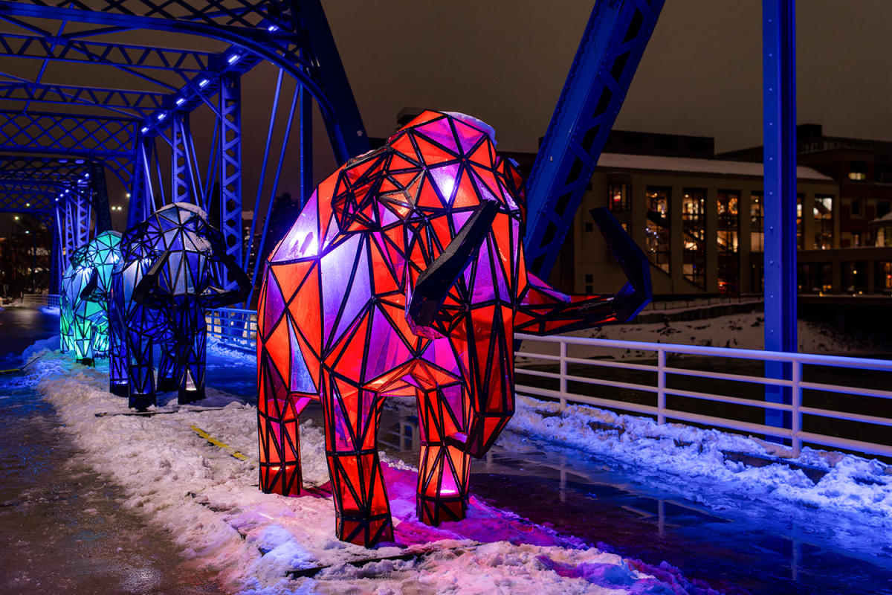
WORLD OF WINTER VOLUNTEERS
Downtown Grand Rapids Inc. is seeking enthusiastic and dedicated volunteers to help us create an unforgettable experience for our community at the World of Winter event. Volunteers help create a winter festival that will warm hearts and create lasting memories for all who attend.
Ready to share in the fun? Use the sign-up link here: https://forms.gle/ra7Dm3sjVMM8gB2U8!
4
Shifts Available:
(1/18) Silent Disco @ Calder Plaza - 7PM - 11PM
Volunteers to work headphone stations (7PM - 11PM)
(2/16) Paint the Park @ Rosa Parks Circle - 11AM - 5PM
Volunteers for paint table
* Snacks and drinks will be provided! * Deadline to sign-up is January 1st.

Slide 6
PADNOS INTERNATIONAL CENTER
Interested in working abroad after graduation? This event is for you! We will cover opportunities such as Peace Corps, Teaching Abroad, Fellowships, Foreign Service, Australia & New Zealand work visa for under 30 year olds, as well as general information for your global job search and preparing to work abroad.
5
Wednesday, November 20, 2024
12:00 pm – 2:00 pm
Kirkhof Center 2264

Slide 7
INDIGI-FEST
Come and join the local Anishinaabeg Community of GVSU Alumni, current students, faculty, and staff in informative, interactive, and engaging workshops throughout the entire day. We will begin with an opening ceremony by a Representative of the Match-E-Be-Nash-She-Wish Band of Pottawatomi Gun Lake Tribal Council to set the foundation for our celebration of Sovereignty, followed by various workshops on food sovereignty, decolonizing social work and education, Anishinaabemowin Language, an introduction to Powwow, and we finish with a movie and panel discussion.
4
Wednesday, November 20
10:30 am – 9:00 pm
Kirkhof Grand River Room

Slide 8
IMPORTANT STUDENT RESOURCES
It is important that all students are given the resources they need to thrive here at GVSU. Learn more about the resources available to you on campus, many of which are available to students at NO COST.
Available Resources Include: Academics, Academic Support, Belonging and Campus Climate, Campus Safety, Finances, and Wellness

