Slide 1
1. RECENT JOB/INTERNSHP OPENINGS | New week, new opportunities to learn and grow as an HTM professional. Check out the listings for jobs and internships!
2. INTERNATIONAL HOSPITALITY STUDENT DAY | Hospitality Today Live is thrilled to unveil the first-ever International Hospitality Students Day(IHSD24), hosted by Grand Valley State University in Grand Rapids, Michigan!
3. UnCon HR 2024 | UnCon is a non-traditional HR conference set up for people specifically in the hospitality industry. GVSU HTM students can attend for free! Use code UNCON24 at check out.
4. GVSU FALL CAREER & INTERNSHIP FAIR | Meet with employers looking to hire for internship and full-time opportunities, and to explore careers and industries! The Career Center is having multiple events to prep for the fair.
5. RECOMMENDATIONS: RESOURCES | This semester the weekly announcements will feature a helpful campus resources for students to utilize as well as local restaurants to visit! If you have a resource or restaurant that you would like to share with the GVSU HTM community, feel free to email rydzewki@gvsu.edu to share on the weekly announcements.
6. STUDENT ACTIVITY: LAKER CON 2024 | Laker Con is a three-day comics convention held at the Mary Idema Pew Library. Our mission is to celebrate comics literacy, the scholarly merits of sequential storytelling and exalt the visual art of storytelling. This event is free and open to the GVSU community and the public.
9.23.2024
Click here to learn more about all GVSU HTM opportunities available to you

Slide 2
New Internship and Employment Opportunities
Wings West Burdick's Server
Greenleaf Hospitality - Kalamazoo, Michigan
Application Deadline: 10/17/2024 Posted: 9/19/24
Lounge Attendant | Morning
Greenleaf Hospitality - Kalamazoo, Michigan
Application Deadline: 10/16/2024 Posted: 9/19/24
Student Assistant - Communications and Marketing
State of Michigan - Lansing , Michigan
Application Deadline: 09/25/2024 Posted: 9/12/24
Supervisor - The Morning Dish
Greenleaf Hospitality - Kalamazoo, Michigan
Application Deadline: 11/6/2024 Posted: 9/6/24
1

Slide 3
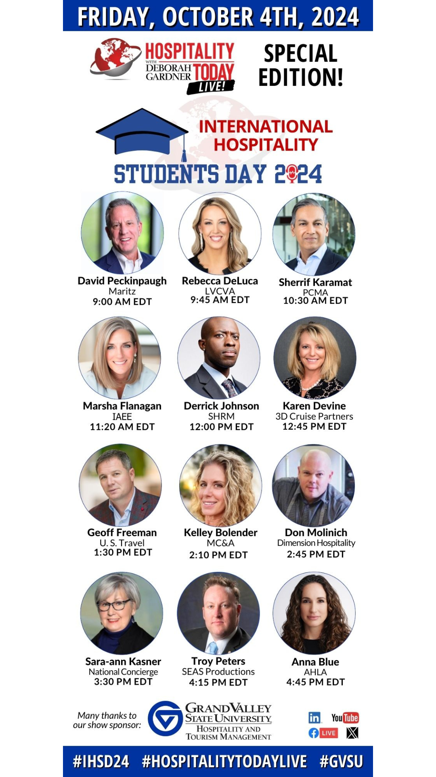
INTERNATIONAL HOSPITALITY STUDENT DAY
FRIDAY, OCTOBER 4, 2024
9 AM – 8 PM EDT
Virtual Event
Hospitality Today Live is thrilled to unveil the first-ever International Hospitality Students Day (IHSD24), hosted by Grand Valley State University in Grand Rapids, Michigan! This landmark event is set to ignite a global celebration dedicated to educating and propelling the next generation of hospitality and tourism professionals.
2
Listen to 12 speakers from various areas of the hospitality industry! This is aa drop-in event; join for as many speakers as you like!
Find further information and registration details on Handshake. Event Link

Slide 4
UnCon HR 2024
You’ve attended all the traditional HR conferences—the ones with the cookie-cutter content and boring industry buzzwords that don’t translate to your workflow. This is not that. This is a conference for owners, supervisors, managers, hospitality professionals, restaurant employees, hoteliers, HR staff, and so many more – focused solely on the restaurant and hospitality industries.
Free admission for HTM students at: https://www.eventbrite.com/e/uncon-hr-2024-tickets-759661216147?aff=oddtdtcreator
Use code UNCON24 for 100% discount
3

Slide 5
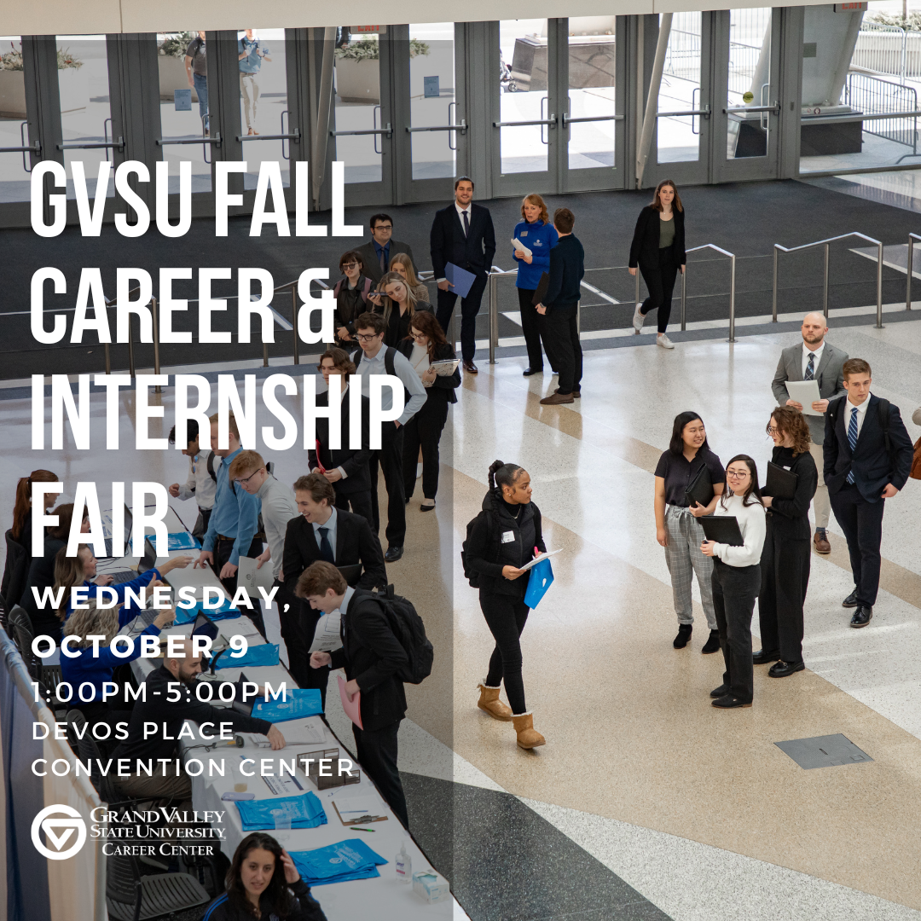
GVSU FALL CAREER & INTERNSHIP FAIR
Wednesday, October 9 1 PM - 5 PM Devos Place Convention Center Join us in the CareerLab at
the Career Center for
prep assistance!
STU 200 | Monday-Friday 11am-4pm
DEV| Tuesday-Wed 1pm-4pm
Virtual Monday - Thursday | 11am 6pm
and Friday 11am-4pm
Not quite sure where to start? Drop in to these events to get
help refining your resume, formulating your elevator pitch,
and learning how to follow up with employers.
OCT. 1 | 3-5pm STU 200
OCT. 8 | 5:30-7:30pm DeVos 105E (Hager-Lubbers)
4

Slide 6
IMPORTANT STUDENT RESOURCES
Farm Stand & Food Truck
It is important that all students are given the resources they need to thrive here at GVSU. Learn more about the resources available to you on campus, many of which are available to students at NO COST.
Available Resources Include: Academics, Academic Support, Belonging and Campus Climate, Campus Safety, Finances, and Wellness
Shop seasonal produce grown on campus at the Sustainable Agriculture Project (SAP)
Grab lunch at Louie’s Lunchbox food truck, featuring fresh produce from the SAP
Wednesday, September 25, 2024 @ 10am – 1pm at the Clock Tower

Slide 7
STUDENT ACTIVITIES
Laker Con
September 27 – 29
Mary Idema Library
Allendale Campus
www.gvsu.edu/lakercon/
6
Laker Con is a three-day comics convention held at the Mary Idema Pew Library in the GVSU Allendale Campus. Our mission is to celebrate comics literacy, the scholarly merits of sequential storytelling and exalt the visual art of storytelling. This event is free and open to the GVSU community and the public.
Friday (9/27) from 10:30 a.m. - 5:30 p.m. Saturday (9/28) from 10:30 a.m. - 5:30 p.m. Sunday (9/29) from 10:30 a.m. - 2:30 p.m.

