Slide 1
1. RECENT JOB/INTERNSHP OPENINGS | New week, new opportunities to learn and grow as an HTM professional. Check out the listings for jobs and internships!
2. MEIJER GARDENS VOLUNTEERING | Frederick Meijer Gardens and Sculpture Park are looking for HTM student volunteers for their Sparkle! 2024 event on December 5th. Many volunteering opportunities available,
3. SUMMER INTERNSHIP | Summer internship opportunity in Northwest Florida. 12-week internship at a vacation rental business with one-on-one training, job shadowing, and guaranteed housing.
4. WORLD OF WINTER VOLUNTEERING | Volunteer at the World of Winter outdoor festival with activities like the silent disco and the painting tables. The festival includes outdoor light installations and activities most of which are free to attend.
5. WINTERFEST | Get in the holiday spirit with two days of festive and fun activities hosted by the Office of Student Life and Campus Activities Board. Activities include a photo booth, bingo, hot chocolate, and much more!
12.02.2024
Click here to learn more about all GVSU HTM opportunities available to you

Slide 2
New Internship and Employment Opportunities
Restaurant Management Internship
Wineguys Restaurant Group - Petoskey, Michigan
Application Deadline: 4/1/2025 Posted: 11/25/24
Event Coordinator Internship
Wineguys Restaurant Group - Petoskey, Michigan
Application Deadline: 4/1/2025 Posted: 11/25/24
Front Office Supervisor
Lodgco Hospitality - Canopy by Hilton Grand Rapids Downtown - Grand Rapids, Michigan
Application Deadline: 12/1/24 Posted: 11/18/24
Banquet Server
Greenleaf Hospitality - Kalamazoo, Michigan
Application Deadline: 12/18/2024 Posted: 11/18/24
1

Slide 3
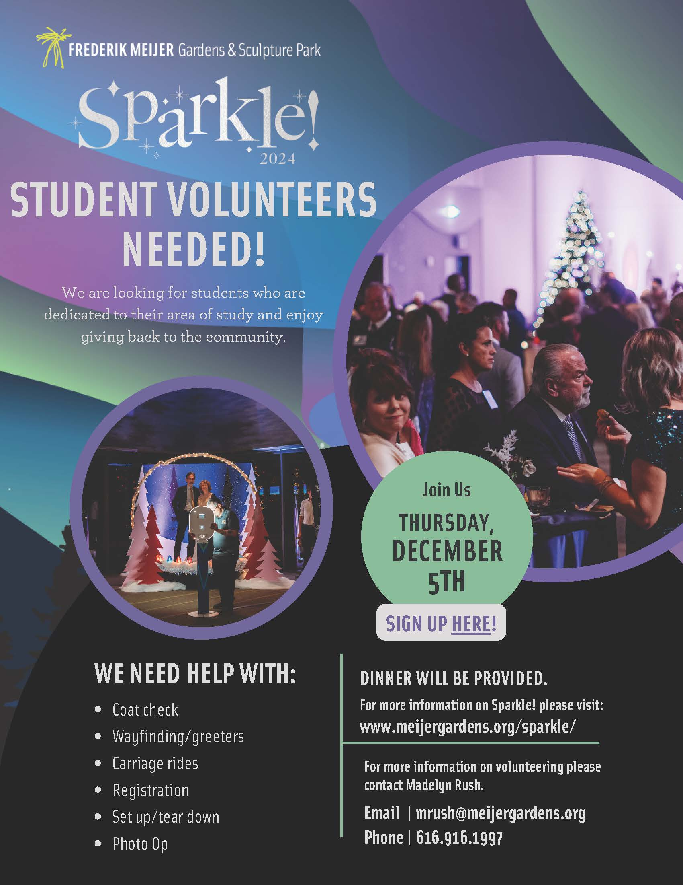
MEIJER GARDENS EVENT VOLUNTEERS
Frederick Meijer Gardens and Sculpture Park are looking for HTM student volunteers for their Sparkle! 2024 event on December 5th.
Event: 5:00 PM to 11:00 PM
Volunteers needed for coat check, greeting guest, carriage rides, registration, and set up and tear down.
Contact: Madelyn Rush
mrush@meijergardens.org
Volunteer Sign Up Page
2

Slide 4
SUMMER INTERNSHIP
ScenicStays offers a 12-week paid internship program in Northwest Florida. The goal is to share an overall understanding of the Vacation Rental Business and the Hospitality Industry through hands-on experience with opportunities to shadow.
You can expect:
College credit
Hourly pay
Housing accommodations
Robust training and mentorship
Experience working with luxurious houses and condos in a dream destination
Cross-department collaboration
Overall growth and development as a hospitality professional
3
Apply at
https://myscenicstays.com/internships/

Slide 5
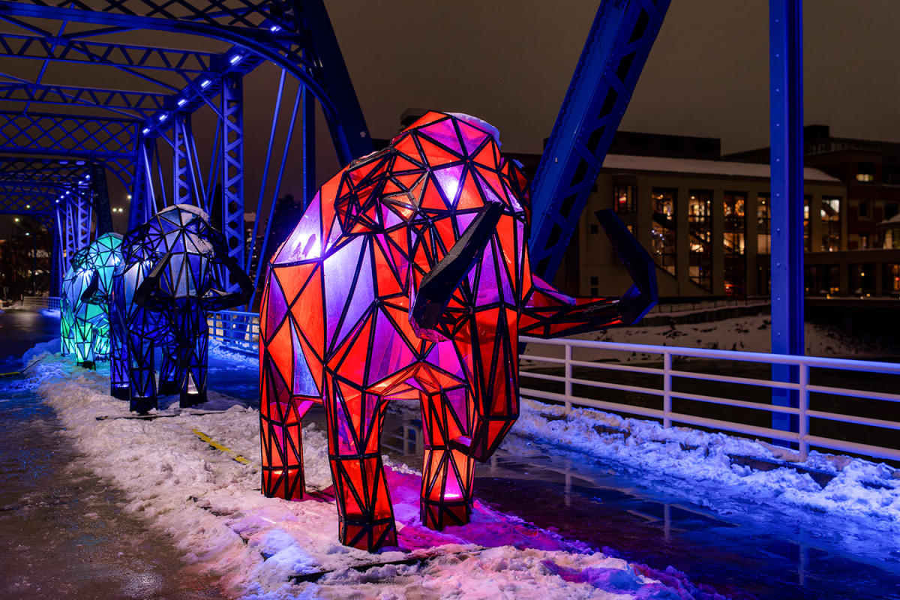
WORLD OF WINTER VOLUNTEERS
Downtown Grand Rapids Inc. is seeking enthusiastic and dedicated volunteers to help us create an unforgettable experience for our community at the World of Winter event. Volunteers help create a winter festival that will warm hearts and create lasting memories for all who attend.
Ready to share in the fun? Use the sign-up link here: https://forms.gle/ra7Dm3sjVMM8gB2U8!
4
Shifts Available:
(1/18) Silent Disco @ Calder Plaza - 7PM - 11PM
Volunteers to work headphone stations (7PM - 11PM)
(2/16) Paint the Park @ Rosa Parks Circle - 11AM - 5PM
Volunteers for paint table
* Snacks and drinks will be provided! * Deadline to sign-up is January 1st.

Slide 6
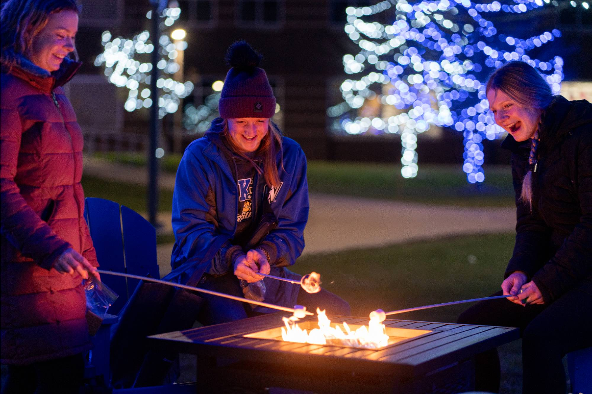
WINTERFEST
The Campus Activities Board and the Office of Student Life host two days of winter fun on the Allendale Campus. Awkward photo booth, cookie decorating, bingo, and a small business market are a few of the activities!
Full list of events
5
Thursday and Friday, December 5th and 6th
All Day
Various Locations, Allendale Campus

Slide 7
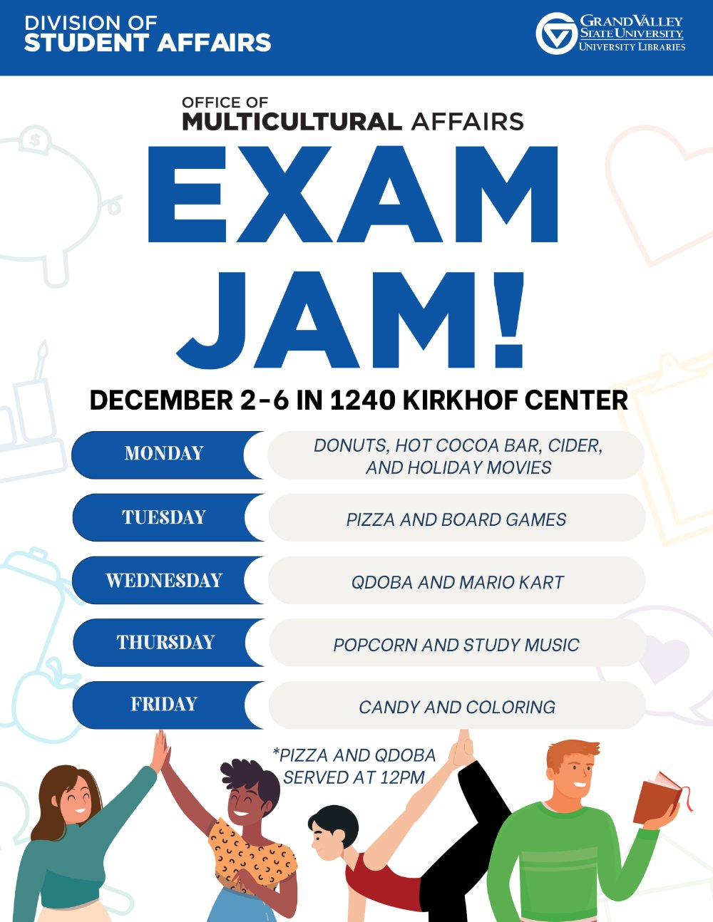
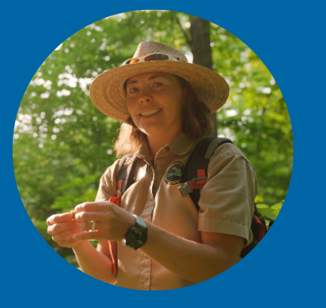
IMPORTANT STUDENT RESOURCES
It is important that all students are given the resources they need to thrive here at GVSU. Learn more about the resources available to you on campus, many of which are available to students at NO COST.
Available Resources Include: Academics, Academic Support, Belonging and Campus Climate, Campus Safety, Finances, and Wellness

