Slide 1
s College of Health Professions 2024 Outstanding Preceptor Awards

Slide 2
Preceptor…
An experienced practitioner who provides supervision during clinical practice and facilitates the application of theory to practice for students

Slide 3
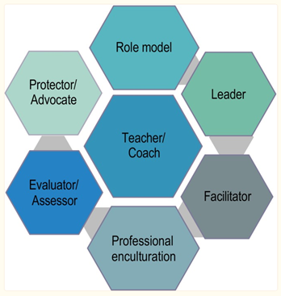
Core Competencies for
Preceptors
Ryan, et al. (2024).

Slide 5
Health Care Program Faculty will present the award to the Preceptors

Slide 6
Anna Bennett, PT, DPT
Physical Therapy

Slide 7
Jennifer Peterman, RD, MBA, IBCLC, LM-diplomat
Applied Food and Nutrition
Healthier Communities

Slide 8
Aaron Reitman
Athletic Training

Slide 9
Jeanette Waite, MS, RDN, CDCES
Clinical Dietetics

Slide 10
Homam Saker, RDMS, OB/GYN, FE
Diagnostic Medical Sonography

Slide 11
Jodi Herman, MS, RHIA
Health Information Management

Slide 12
Alicia Street, MLS [ASCP]CM
Medical Laboratory Science

Slide 13
John Mieras, OTRL
Occupational Therapy
Cheever Treatment Center

Slide 14
Emily Wehr, B.S., R.T. [T]
Radiation Therapy

Slide 15
Haleigh Clark, BS, RDCS, RVT
Cardiovascular Sonography

Slide 16
Lesley Coghill, LMSW
Public Health

Slide 17
Kayla Jeltema, CTRS
Recreational Therapy

Slide 18
Leah Krosschell, M.A. CCC-SLP
Speech-Language Pathology

Slide 19
Heidi Schmeltzer, AuD. CCC-A
Audiology

Slide 20
Stephanie Jobin, CMD
Medical Dosimetry

Slide 21
Shamarie Regenold, MSN FNP-BC
Physician Assistant Studies

Slide 22
Congratulations to all of our 2024 Outstanding Preceptors !
Thank you for teaching the next generation of health care providers.

Slide 23
Ryan, C., Cant, R., Hughes, L., Ahchay, D., & Strickland, K. (2024). Core competencies for registered nurse preceptors: A mapping review of quantitative studies. Nursing Open. 11(2)

